Slide 1
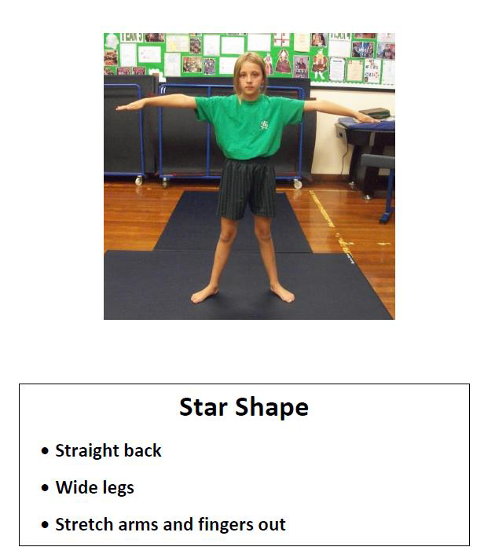
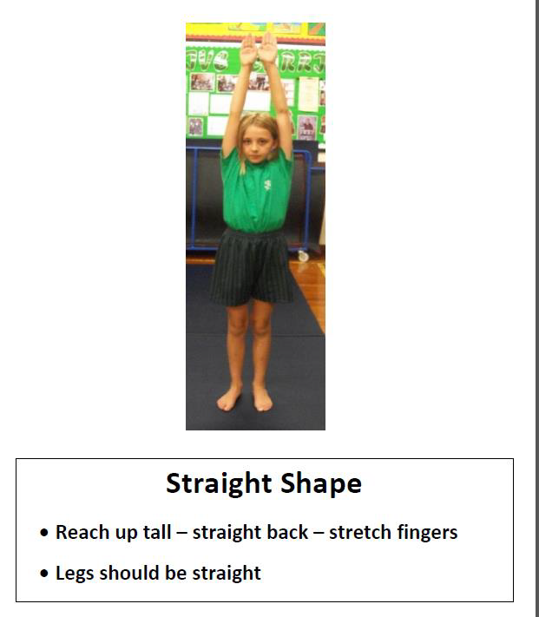
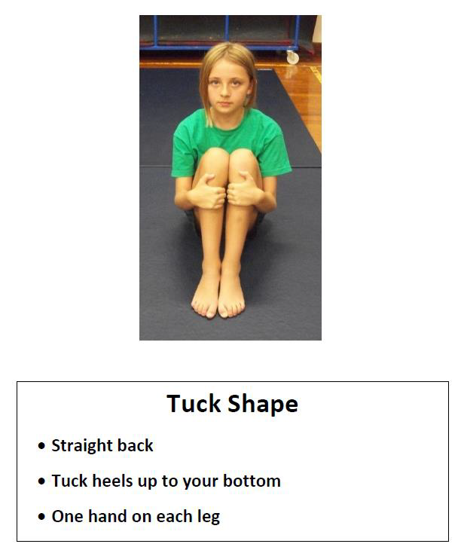
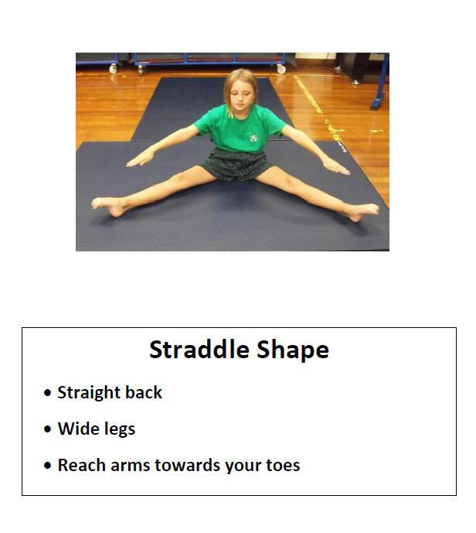
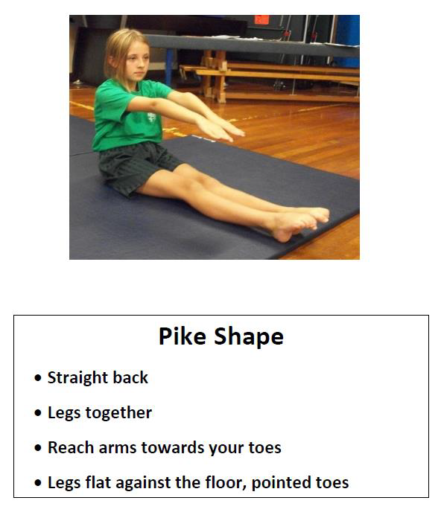
Five Basic Shapes

Slide 2
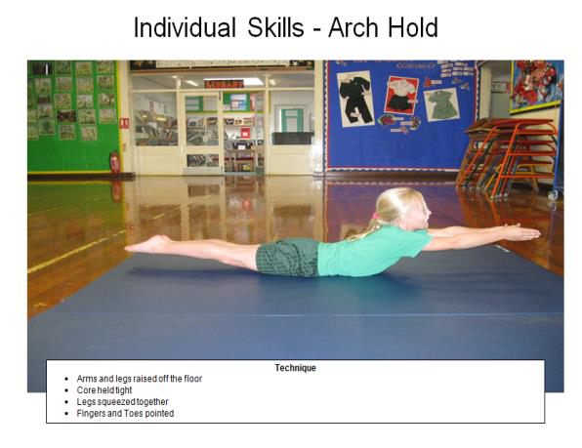
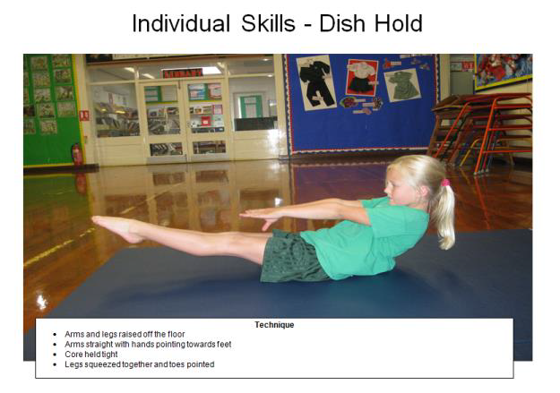

Slide 3
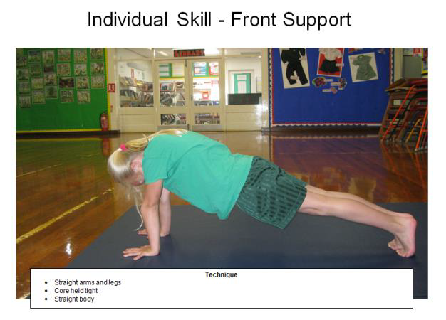
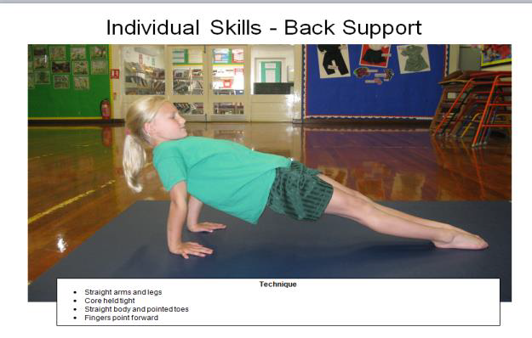

Slide 4
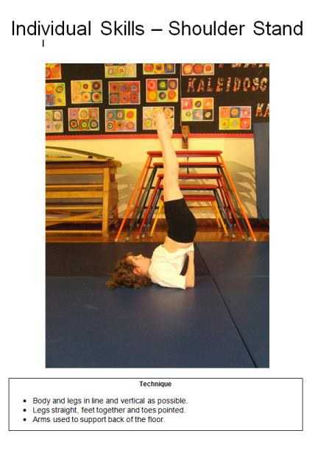
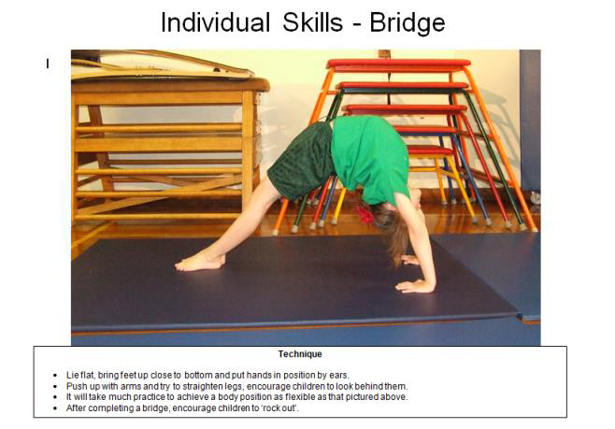

Slide 5
Creating a Sequence
Travel

Slide 6
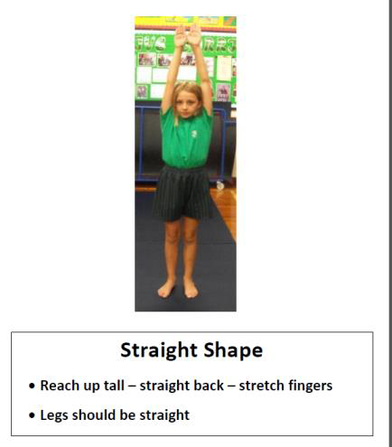


Start and Finish
Travel

Slide 7
Apparatus set up (See Word Document)

Slide 8
How many different ways can we jump off the apparatus?
How can we do this safely?

Slide 9
Which balances have we practised today?
Which balances are safe to do on the apparatus?

Slide 10
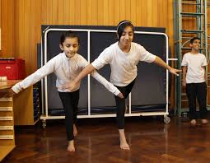
Use the sugar paper to plan your…
Starting position
Balance on the apparatus
Jump to get off the apparatus
Travelling on the mat
Balance on the mat
End position
YOU NEED TO MIRROR EACH OTHER

