Slide 1
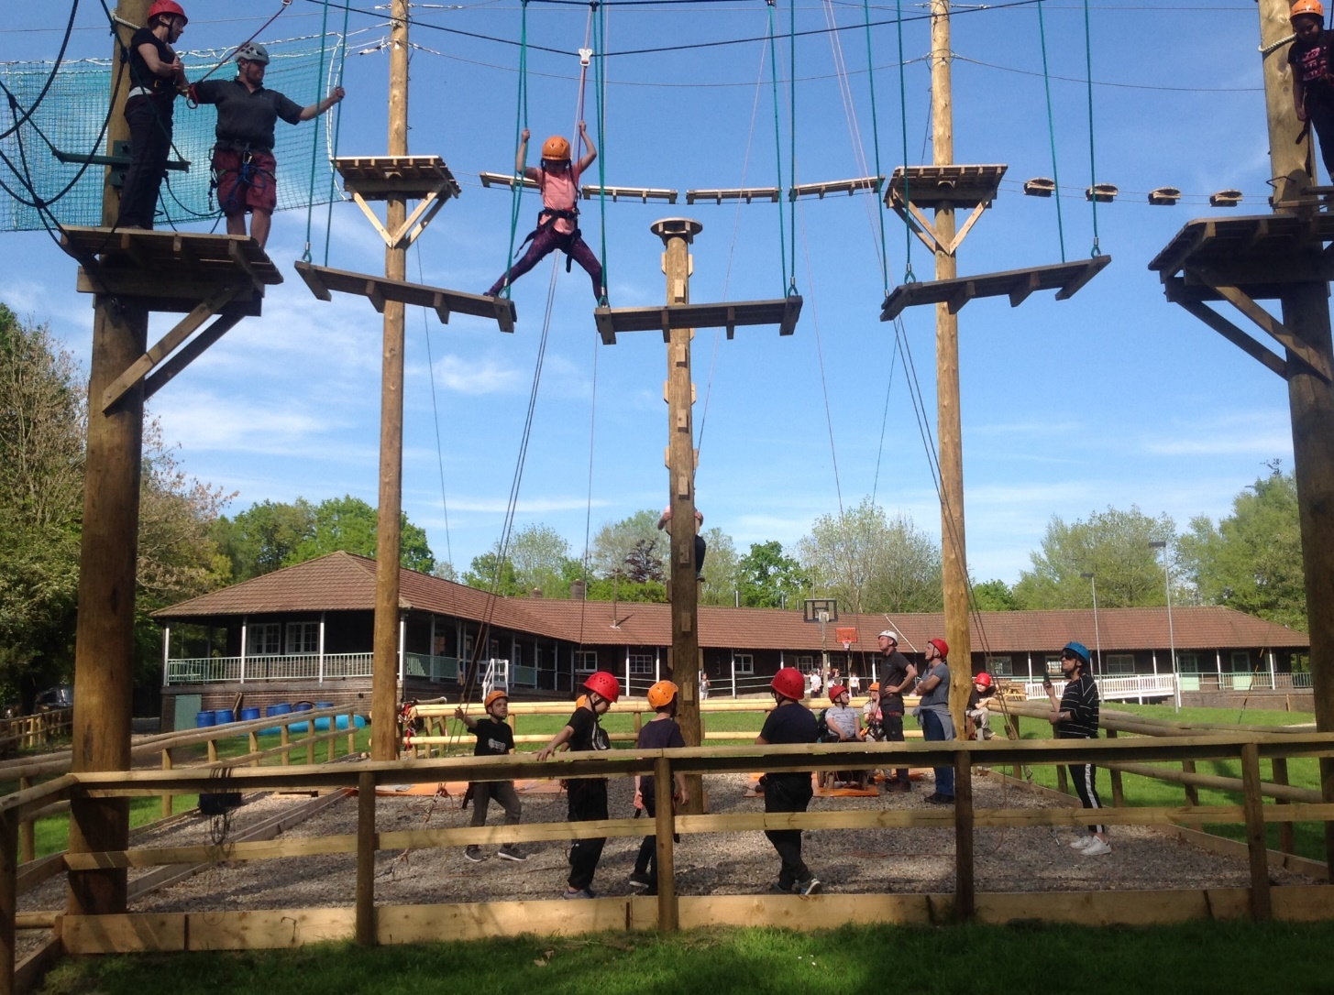
Bell Heath Residential Trip 2026
Wednesday 22nd April – Friday 24th April 2026

Slide 2
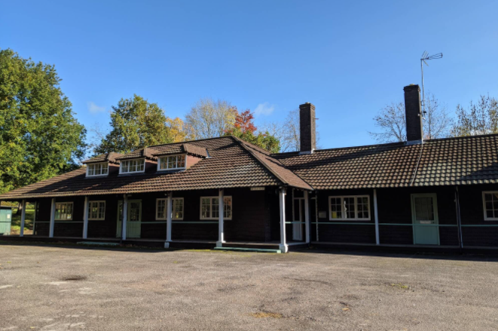
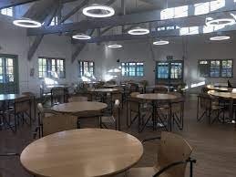
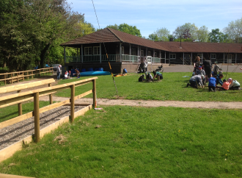
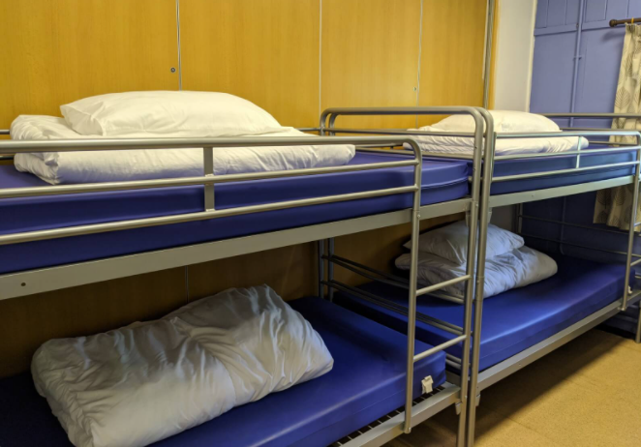
Notes:
Located on the outskirts of Bromsgrove in Belbroughton. 7th Year . Run by Boundless outdoors – company we have used for nearly 20 years

Slide 3
The aims of the trip..
To experience a residential trip, staying in a group away from family members.
To develop skills of co-operation, following instructions and facing new challenges in a different environment.
To try a range of new outdoor activities that have not been available to them before.
To have fun!

Slide 4
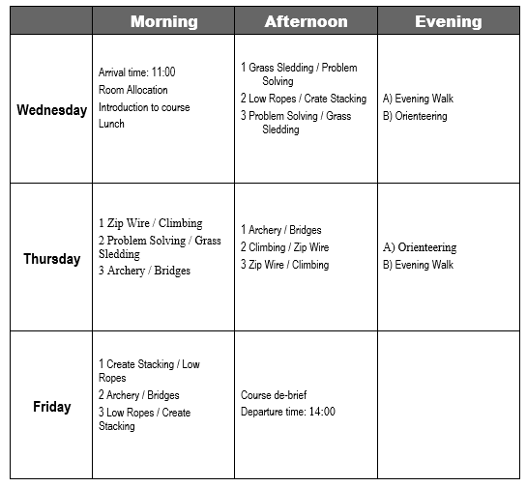
Notes:
3 groups – at least 1 member of staff with them at all times. Activities led by centre staff – thoroughly trained and have all appropriate qualifications. These are the activities the children will be taking part in

Slide 5
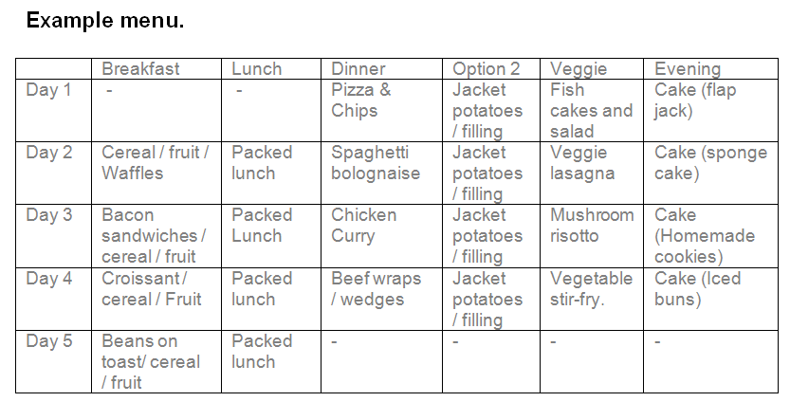
Food
Notes:
Very impressed with quality and variety of food available – dietary requirements

Slide 6
Bell Heath Kit List
Several changes of loose fitting clothes are the best.
Single sheet, duvet cover & pillowcase or a sleeping bag and pillowcase if preferred.
wellington boots
tracksuit bottoms are the best - no jeans because if they get wet they take a long time to dry and can rub when wearing a harness
sweatshirts or jumpers
t-shirts, long sleeve t-shirts, shirts
several pairs of thick warm socks
several changes of underwear
warm waterproof coat
hat and gloves (it may still be cold in the evenings)
sun cream + sun hat/cap (depending on the weather forecast)
two pairs of footwear (one for indoor, one for outdoor use)
small rucksack
small sandwich box (empty)
drinks bottle
hand towel - wash bag, toothbrush, toothpaste, flannel, soap, hairbrush and comb
shower towel
pyjamas (and teddy bear!)
a black bag or carrier bag for dirty clothes to be placed in
Notes:
Also available on year 4 page of school website. Shower facilities – bring towel and flannel. No best clothes. If packing Wellies – bring another pair of outdoor shoes. Helpful if children help with packing - please don’t send children with food in their bags – not allowed in dormitories

Slide 7
What will happen on the day…
Wednesday 22nd April
The children will need to bring their bags with them when they come to school in the morning.
The children won’t need to come to school in their uniform on that day, they can come in the clothes they will be travelling to Bell Heath in.
We are hoping to leave school at approx. 10.30am.
Notes:
Contact you closer to the day to let you know where these will need to be dropped off.
Please can the bags be clearly labelled with the your childs name.
Leaving at the bottom of Longdon Close – welcome to come and wave us off

Slide 8
Children will need to bring a drink and a packed lunch. Please can this be placed in a rucksack for the children to bring with them on the coach.
No phones, electronics or cameras to be taken. No valuable items.
No sweets or food.
Please can all jewellery be removed – earrings can get easily caught in helmets.
We will back at school by 3pm on Friday 24th April.
Notes:
.

Slide 9
Facebook
We will be posting updates and photos of what we are getting up to on Facebook.
If you DO NOT want photos of your child to be put on Facebook please let me know ASAP.
Notes:
Staff will take lots of photos which we will share on our FB page – please let us know if you do not want pictures shared on FB. We will try our hardest to post photos of all children every day – however we only have 1 school phone to do this so please bear with us

Slide 10
Other information…
Medicines
If your child is on any medication or uses an inhaler could you make sure that it is handed in at the office on the morning of the trip at the very latest in a clearly labelled bag and with a completed medical form, available from the school office. Please don’t pack any medication in the children’s luggage.
Notes:
If you have a specific worry about your child or any aspect of the trip please come and see me.

Slide 11
What to do in an emergency.
If you have a family emergency while we are away during school hours please contact the school and they will contact us.
If it is outside school hours there will be an emergency contact number you can call – this will be provided closer to the day.

Slide 12
Consent form
Please can you complete the consent form and return it ASAP.
Thank you!
Notes:
If any details change before our trip please let office know. Send out another letter closer to the day

