Slide 1
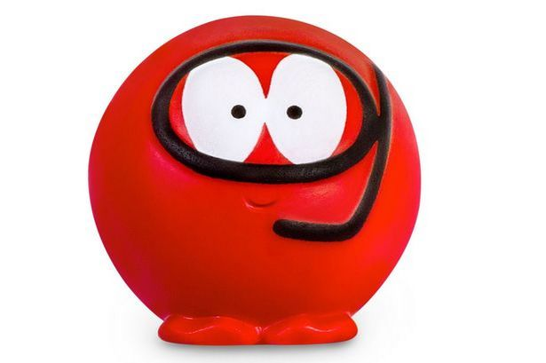


Red Nose Day for us is on
Thursday 17th March
This year we are inviting children to dress up and make a donation to Comic Relief.
Children should dress as a hero – this could be a superhero like batman; a hero from a book like Gangsta Granny or a film like Frozen; a community hero like Captain Tom Moore or Marcus Rashford or a sporting hero like Emma Raducanu. It could even be a family hero like your Mum!
Anything goes – but please NO MASKS.
Face paint is fine, as is coloured hair etc.
Children should dress to impress!
Please make a donation via our special Parent Pay Page https://app.parentpay.com/ParentPayShop/Foc/Default.aspx?shopid=7040

