Slide 1
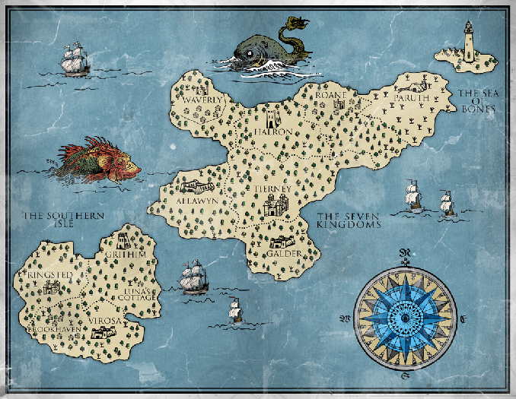
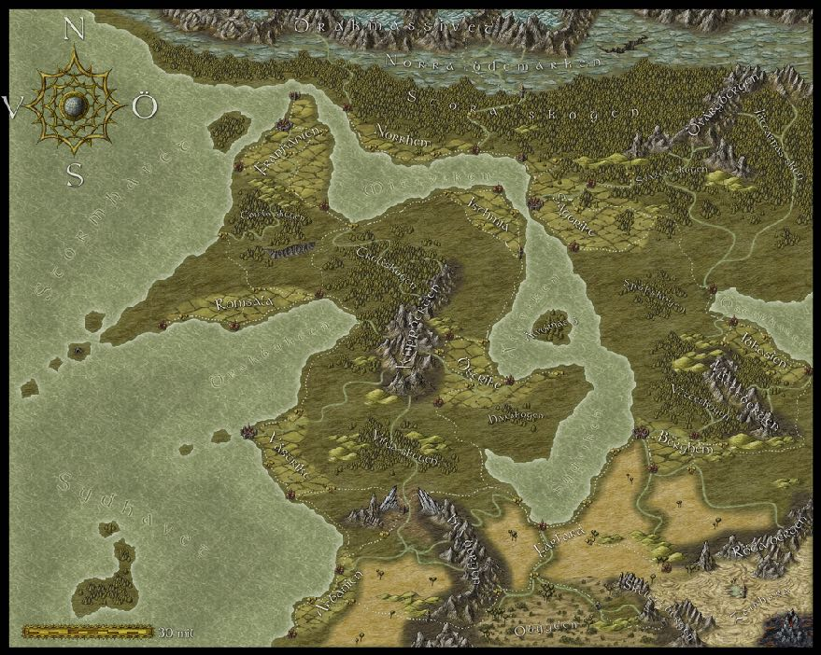
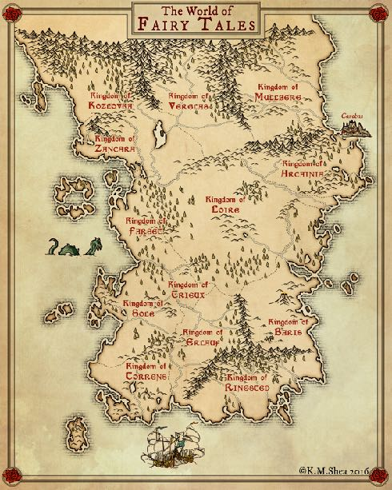
Web Links
Click on maps to view on the internet
Notes:
Again, depending on the age of the children you might explore some mapping skills and vocabulary here - compass points, symbols etc.

