Slide 1
Episode 1
A person with a problem

Slide 2
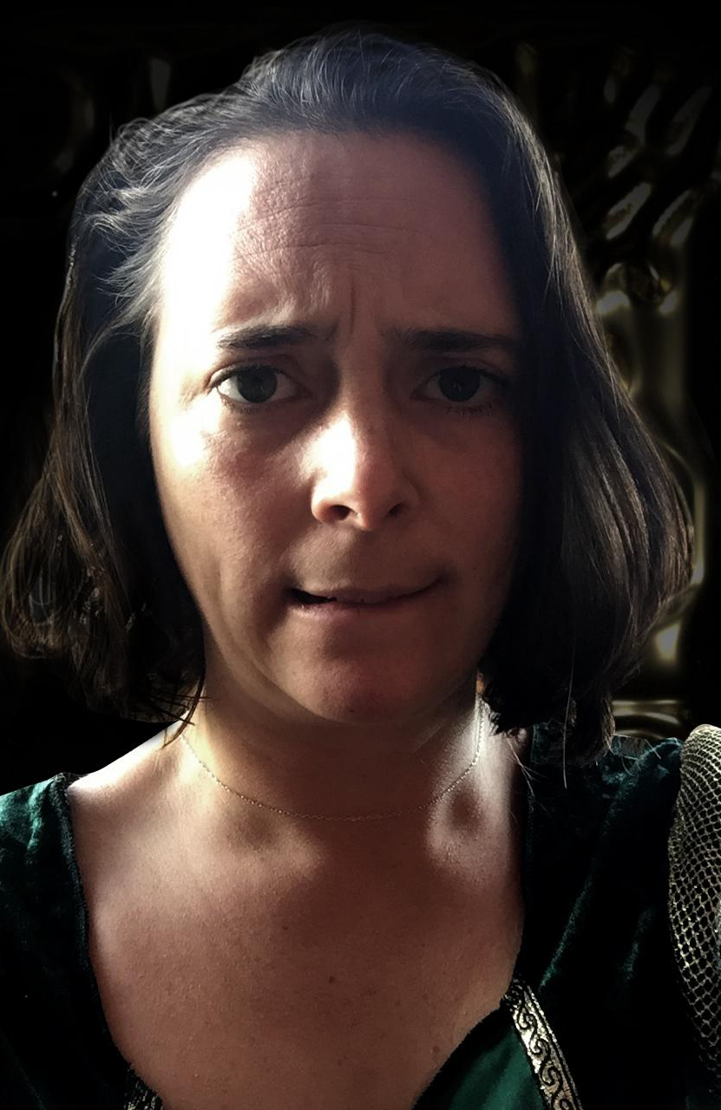
Here is someone with a lot on her mind.
She sits and stares at the floor, her hands twisting and turning, her back bent, and her legs clamped tightly together.
She shifts slightly and looks up as if someone has entered the room.
But there is no one there, she is all alone.
Notes:
You could describe her or show her - taking on the role for your children. Ask them to think of words to describe her mood.

Slide 3
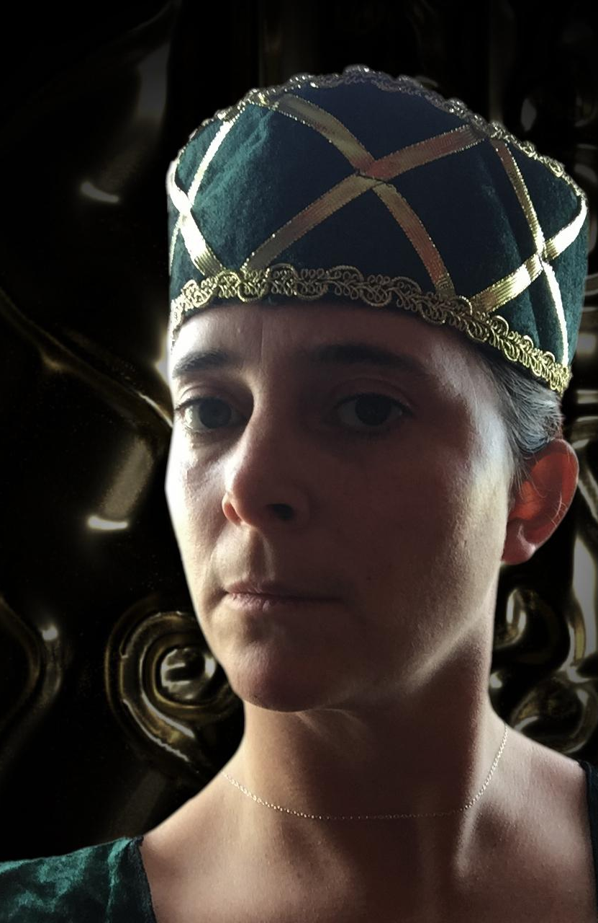
On her head is a crown…

Slide 4
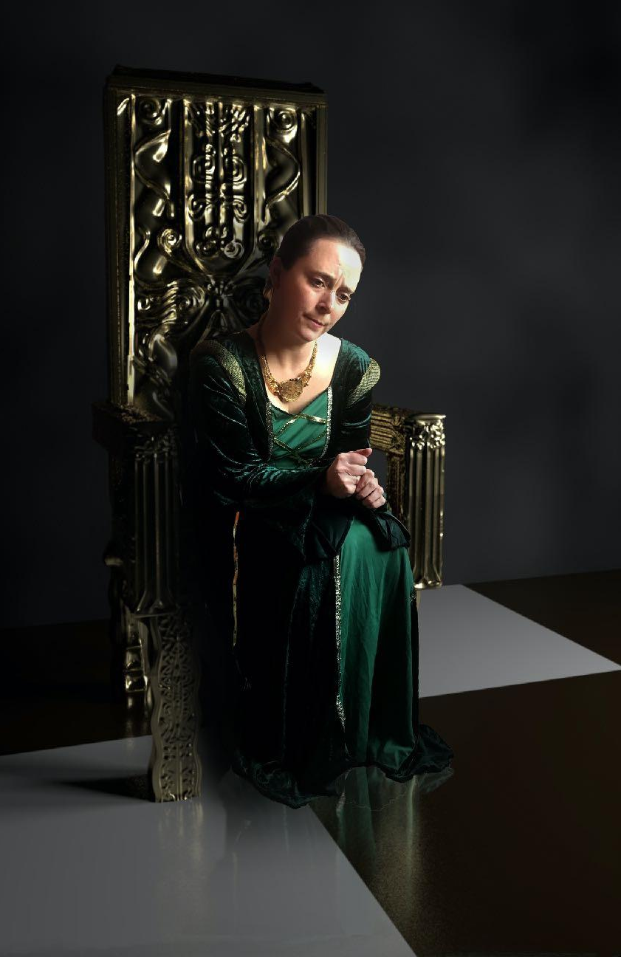
And she wears a beautiful green dress with gold trimmings.
She is sitting in a room at the top of a tall tower…
In the kind of castle you might find in a fairytale.
Notes:
If we are in a fairytale time, what would we NOT find in a castle? Could you write a list and then think of things we might find inside a fairytale castle - we can see her throne. What else?

Slide 5
Activity 1
A castle
Notes:
Go to the Fact File for your Architecture of a Castle information sheet

Slide 6
For this activity you will need:
1. A sheet of paper (large, if possible).
2. Pencils or pens to draw with.
Please take as long as you like, the story will be waiting for you when you finish.

Slide 7
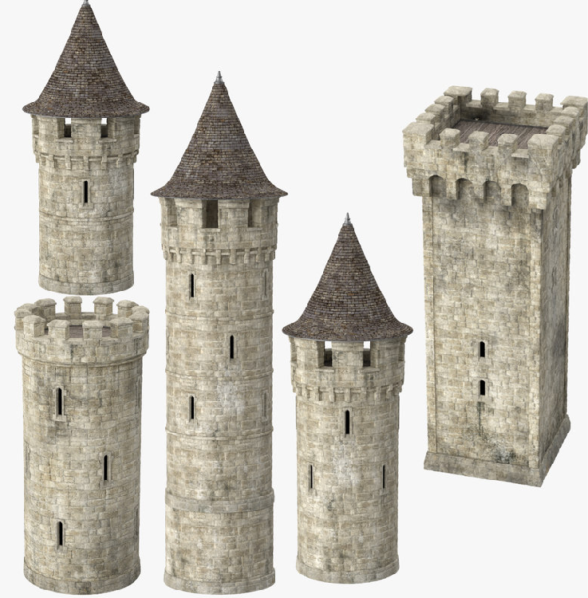
Please draw as we go along…
The Queen’s castle has four tall towers, each with a flag flying in the wind.
Choose a design you like, here are some possibilities…

Slide 8
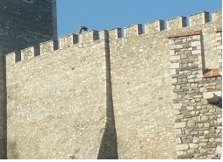
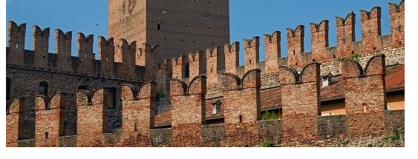
There is a wall joining the towers with battlements along its length.
Here are two kinds…

Slide 9
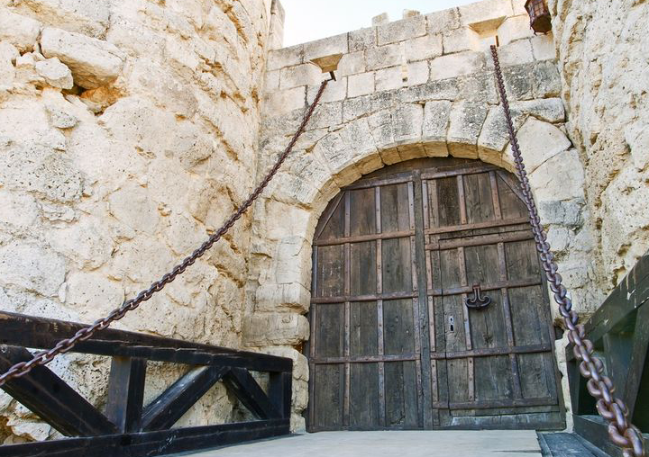
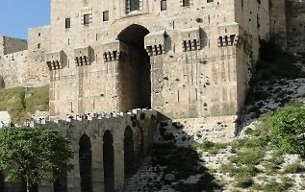
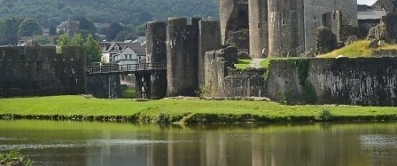
And a great gate, with a drawbridge and a moat…
Something like…

Slide 10
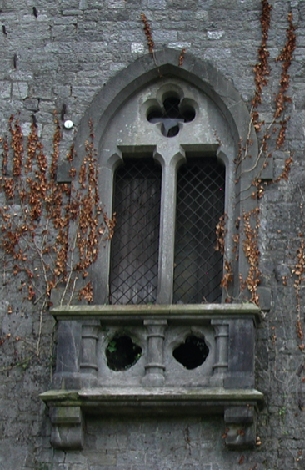
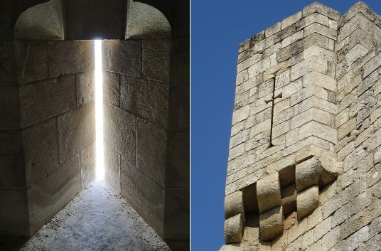
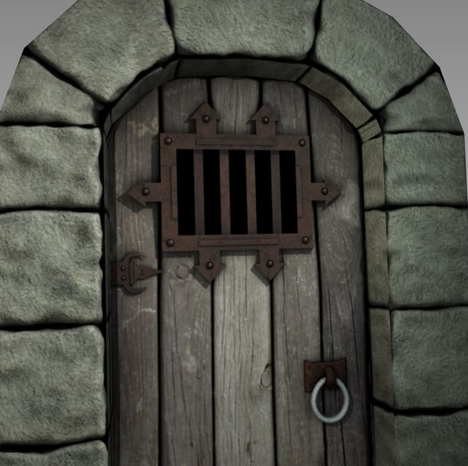
There are windows and arrow slits in the castle.
And, deep down underground, a dungeon for criminals and those who plot against the queen.
Notes:
Depending on the age of your children you might take some time to explore the purpose of some of these features of a castle and think about how they might have been built and with what materials.

