Slide 1
Episode 2
High up in the tower

Slide 2
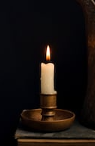
High up in the tower is a window and shining out of the window is the light of a candle.
The candle rests on a small table next to the queen. The light illuminates her face and casts a faint shadow across the floor.

Slide 3
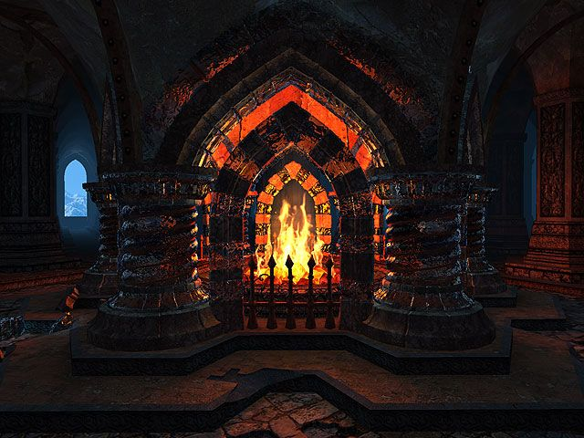
Crackling in the corner of the room are logs in an old stone fireplace.
Everything else is silent, unmoving, as though the castle was holding its breath.

Slide 4
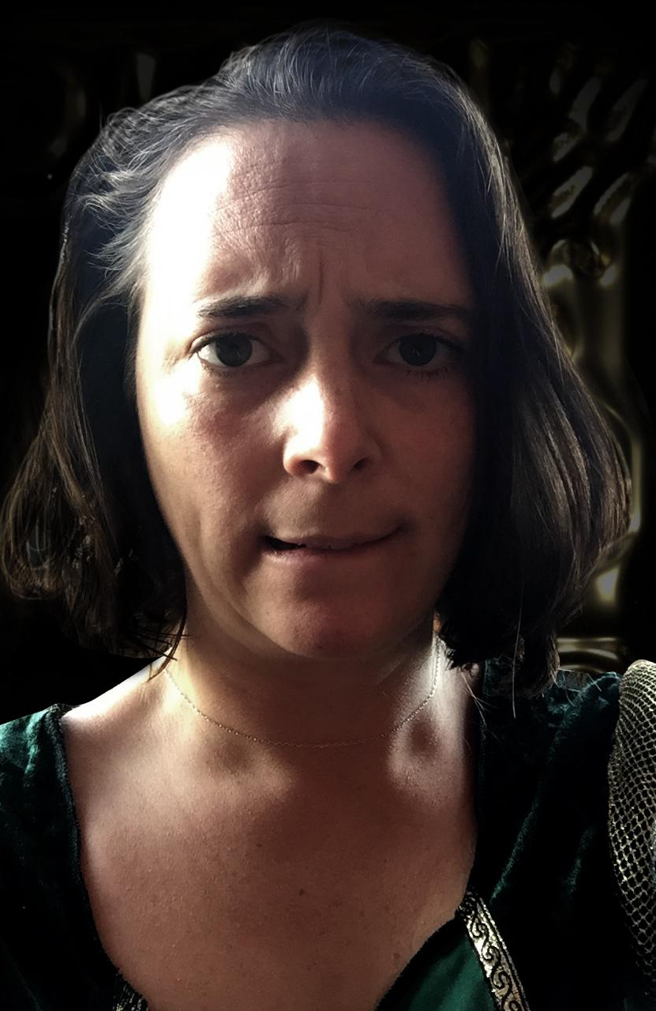
The Queen murmurs and rests her head in her hands.
“What am I to do?” she whispers to herself.
“They are causing so much damage and unhappiness?”

Slide 5
What kinds of things do you suppose would trouble a fairytale Queen?

Slide 6
You might want to make a list and see you how close you get!

Slide 7
“If only,” she says, “they would stay in the forest and keep away from the village?”

Slide 8
“Why do they have to eat the sheep?”

Slide 9
Any idea yet?

Slide 10
“Isn’t there enough food in the woods?”

Slide 11
Here it comes…

Slide 12
“Those trolls are the bane of my life!”

Slide 13
Activity 2
Trolls
Notes:
Go to the Resource Folder for your ‘How to Draw a Troll’ information sheet

Slide 14
What have you heard about trolls?

Slide 15
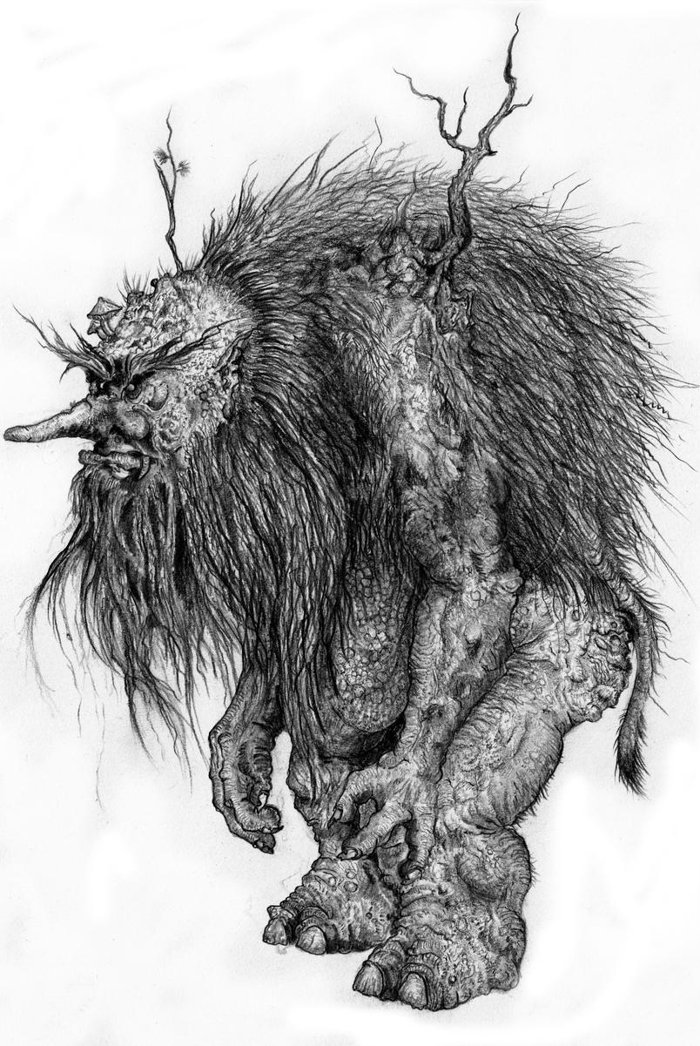
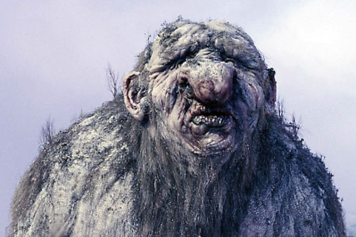
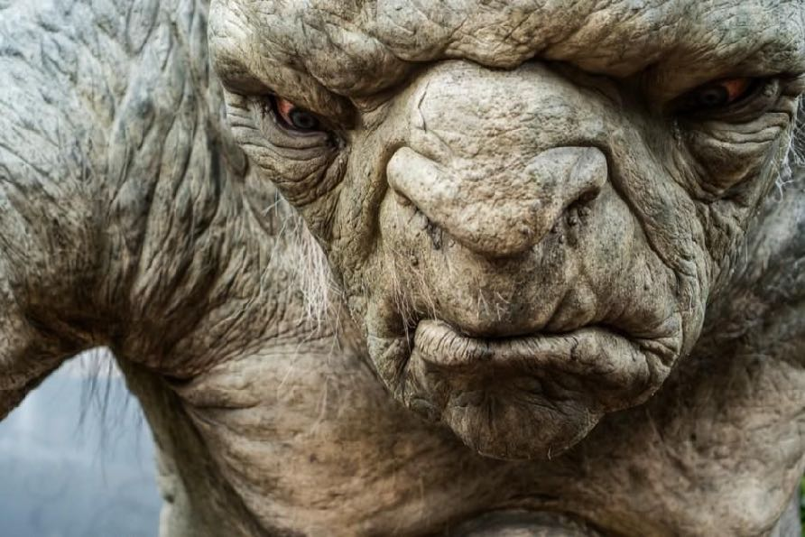

Slide 16
What are their heads like?
Their arms?
Their legs?
What does their breath smell like?

Slide 17
How do they walk?
How do they eat?
What do their voices sound like?

Slide 18
You could have a go at being a troll if you like?
If you do…
Stand up. And try moving around.
How do your arms move? How about your head? What about your mouth?

Slide 19
What do trolls eat?
Some people say they only come out at night.
Others say, they enjoy their own company and live on their own.

Slide 20
Perhaps it is lonely being a troll.
Perhaps they don’t care.

