Slide 1
Episode 3
Helping the Queen

Slide 2
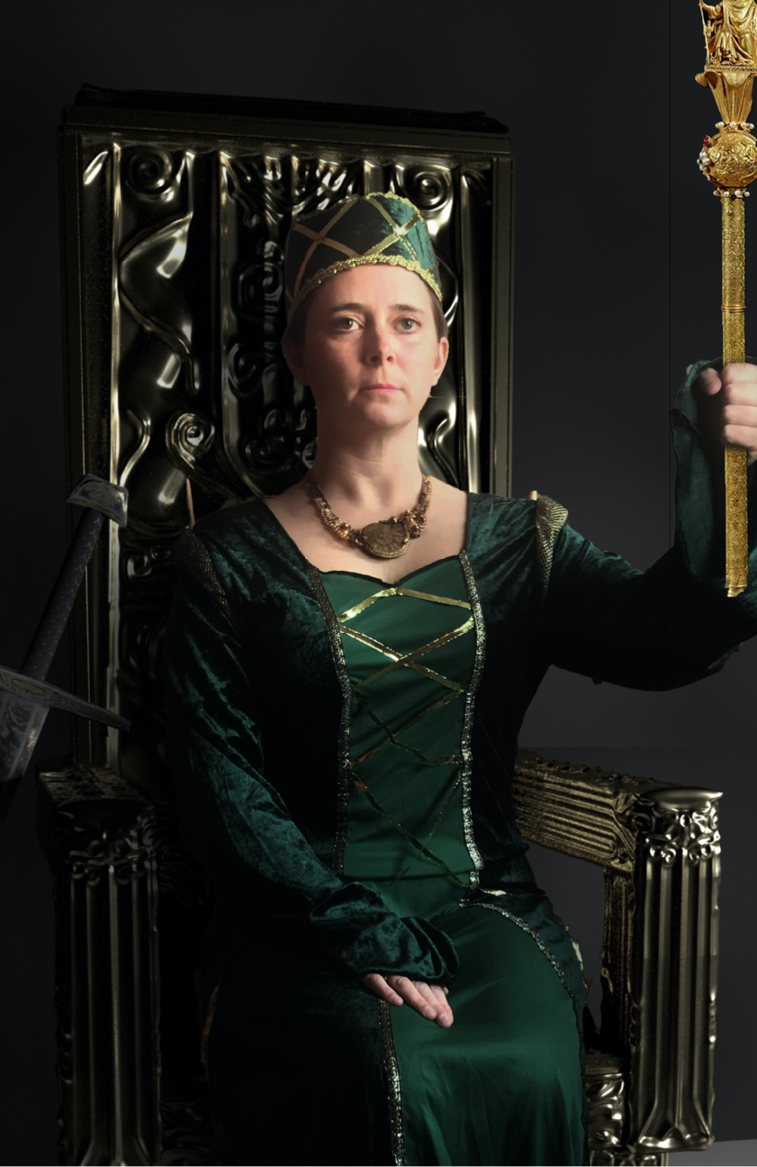
The Queen sat on her golden throne, her back straight, her eyes fixed across the room, darkness surrounded her. Half hidden by shadows, was the blade and handle of her long sword.
The creak of ancient hinges announced the arrival of the only people who could help her.

Slide 3
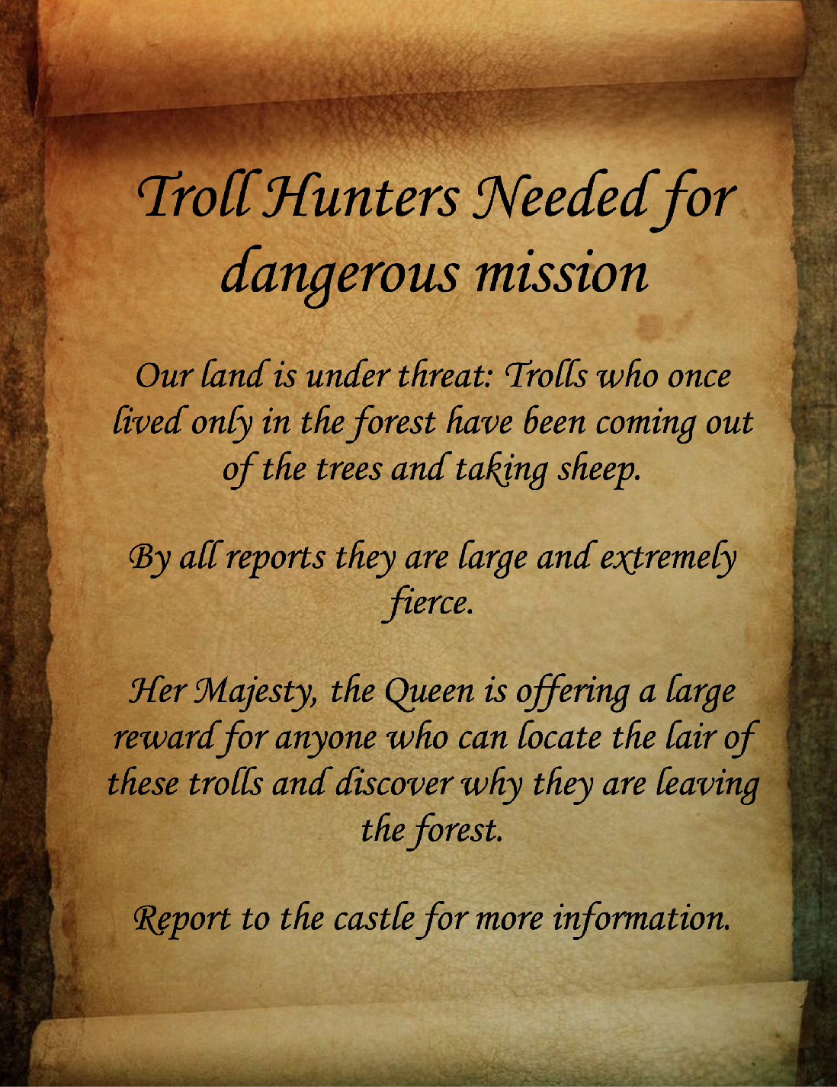
A proclamation had been sent out to every corner of the land.

Slide 4
If you had come to help the Queen in this story, what would you want to know?

Slide 5
Let’s see if you get any answers…

Slide 6
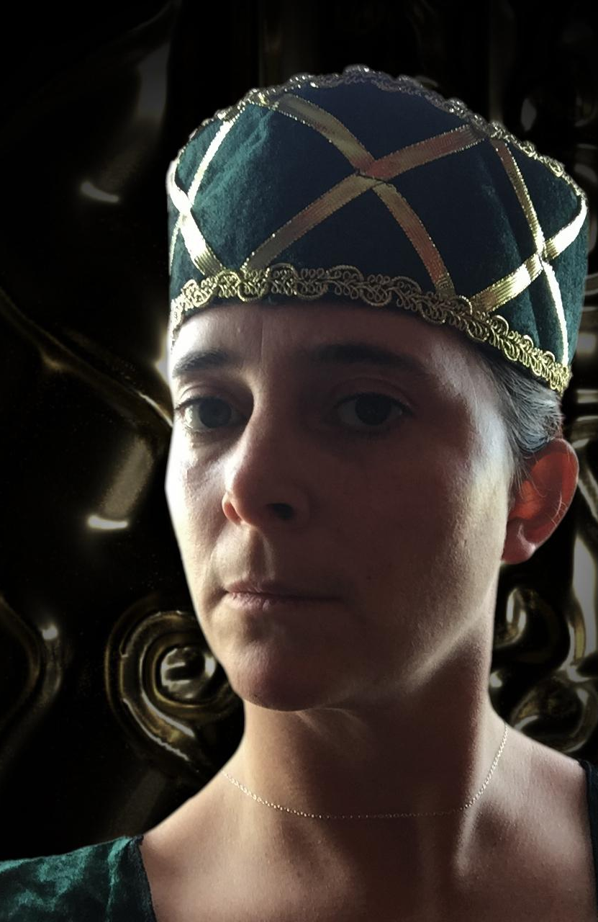
The Queen looked down at those who had answered her call…
“Your mission is to travel to the forest at the edge of our land,” she said “to find a way into the forest and to locate the lair of the Trolls.
“Once you have found it, you are to hide and to watch. I wish to know what they are doing and why they are leaving the forest and stealing our sheep…

Slide 7
“Do not be seen, do not be heard. Watch only and send back reports.
“These Trolls are dangerous and we don’t yet understand their intentions.
“Your mission is find out more, so we can act with intelligence.”
With that, the Queen signalled they may leave.

Slide 8
Activity 3
Equipment
Notes:
Go to the Resource File for your ‘Equipment we need to fight a Troll’ template list

Slide 9
What kind of equipment do you think you would need for a job like this?

Slide 10
It sounds like there is a lot of hiding, watching, and recording. I suppose camouflage would be useful, and a pair of binoculars (or such like), and something to make notes with.

Slide 11
Probably a good idea to make a list. If you have a piece of paper handy and a pencil. You might want to draw the things you are going to need and maybe write them down.

Slide 12
Have you got a tent? This sounds like a long mission.
How about rope? Rope is always handy.
And a first aid kit, that would probably be a good idea.
Also, some food for the journey. Who knows where the next meal will come from.

