Slide 1
Episode 4
A sleepless night

Slide 2
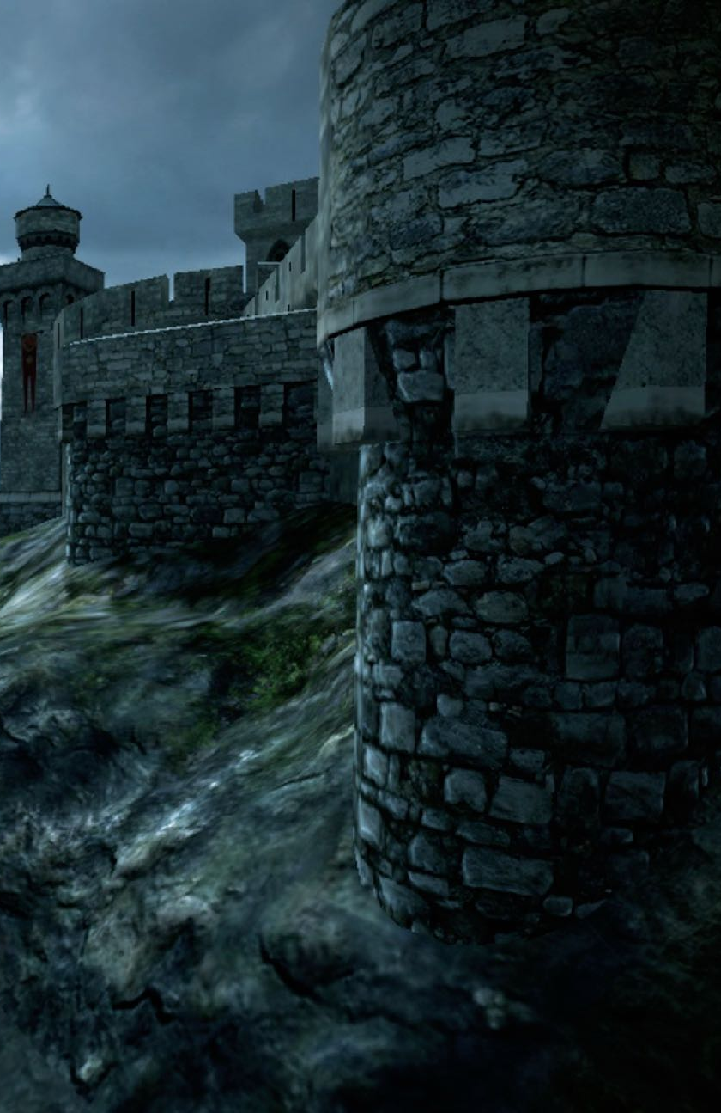
That night, the adventurers slept badly.
Outside they could hear the howl of the wind as it rushed about the castle walls.
It sounded almost like the baying of hungry wolves come to get their fill.

Slide 3
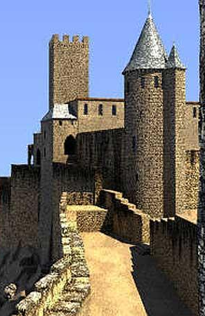
In the morning they left their room and went down to the castle storehouse.
Everything they asked for was laid out on the store room tables.
They packed their backpacks, tightened the straps, and walked out across the drawbridge.
Their adventure about to begin…

Slide 4
Activity 4
Map

Slide 5
What do you suppose a map of a fairytale kingdom would look like?

Slide 6
We know there must be a castle - probably on a hill.
We know there must be a forest far away from the castle
We know there must be villages and fields with sheep for the trolls to steal.

Slide 7
What other sorts of things are going to be on the map do you suppose?
You might want to draw it if you have some paper handy (you’ll need be a big piece if it is a big kingdom) and some pencils and pens to draw with.
Before you start you might want to take a look at some examples on the Internet. There are links on the next page.

