Slide 1
Chapter 2:
Into the Forest

Slide 2
Episode 1
Finding the way across a fairytale kingdom

Slide 3
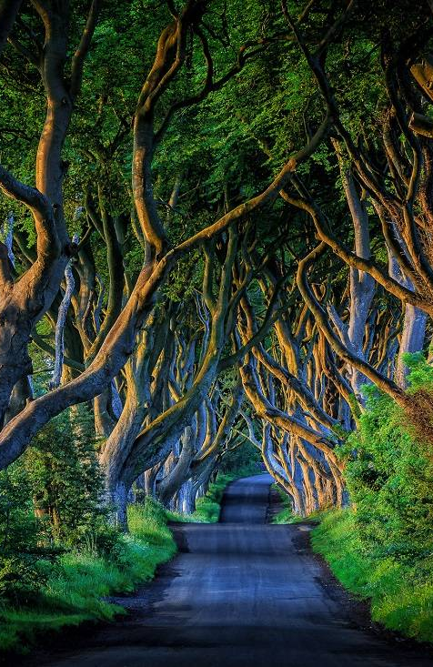
The adventurers had been walking all day. Their legs were tired, their backs ached.
The road from the Queen’s castle was long and marked with holes.
Dark puddles of unreliable depth crossed their path, making it slow and difficult going.
High up in the sky they could see the black silhouettes of sinister looking birds.
Image Credits: www.adrianchandler.com

Slide 4
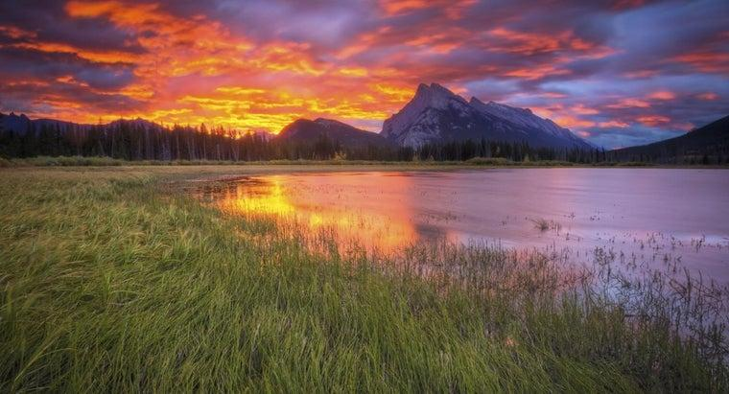
Looking down at their maps they began to work out how far they had walked and how much further there was to go.
They had set off as the sun rose at 6:00 in the morning and were still going as the sun disappeared 14 hours later behind the mountains to the west.
And they were still only half way across the map!

Slide 5
Activity 1
Only half way

Slide 6
Activity 1: Only half way
Take a look at the map you brought with you, how far have you come? If one centimetre equals one mile - how far have the adventurers walked in a day?
And how much further have they got to go?

Slide 7
Would it be quicker to leave the road? It might be straighter, but, as someone famously said, “Short cuts make long delays!”
What do you think, is it worth the risk?

Slide 8
Take a look at your map, what risks do you think the adventurers would be taking if they left the road and what risks might there be if they stayed on it?

Slide 9
Imagine what this part of the story might sound like in a book? Great adventure stories always have peril - scary things that happen to the heroes when there looks like there is no way out!
Shall we have a go at writing this part of the story?

Slide 10
Take a look at the map and find a place where something bad is going to happen - maybe the adventurers’ are attacked by a monster or a wild animal.
Now work out what will happen to make the reader think, “Oh no, there is no way out of this!” Perhaps the jaws of the monster are about to close about the adventurer’s head.
Now think of a way out! A miracle of strength, or perhaps the adventurer is rescued.
Have a go. You might want to play it first or draw a picture until you have got it clear and are ready to write.

