Slide 1
Woodland animals
We have been looking at the animals that might live in or next to Stick Mans tree. We call these woodland animals.
On the next slide there are pictures of different animals, some are woodland animals and some are not. You need to decide which animals live in the woodlands.
You might want to look at this website to help you: https://www.woodlandtrust.org.uk/trees-woods-and-wildlife/animals/

Slide 2
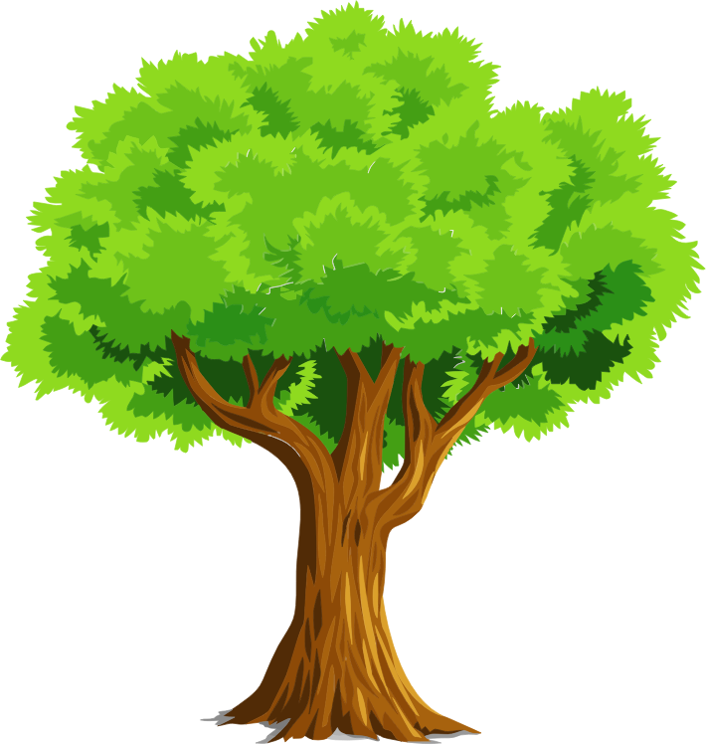
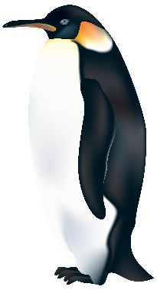
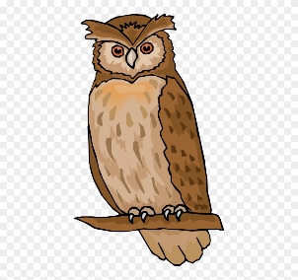
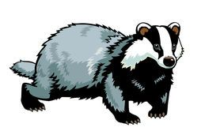
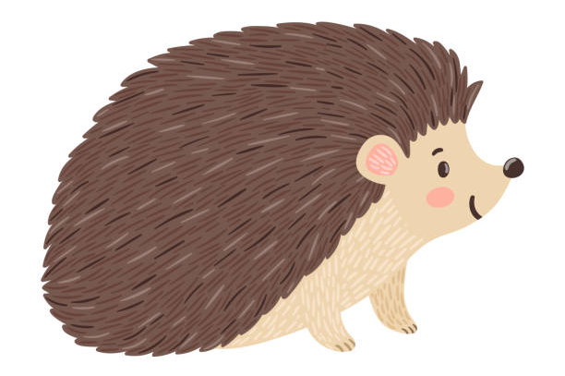
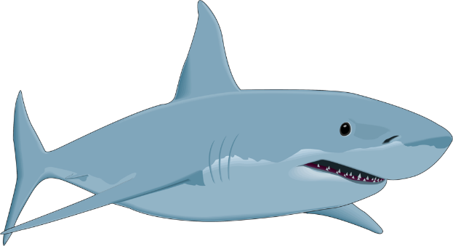
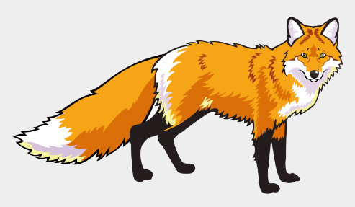
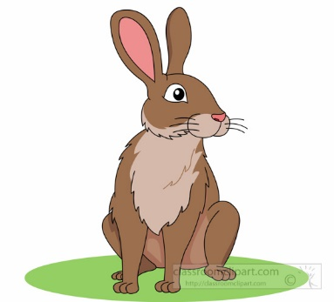
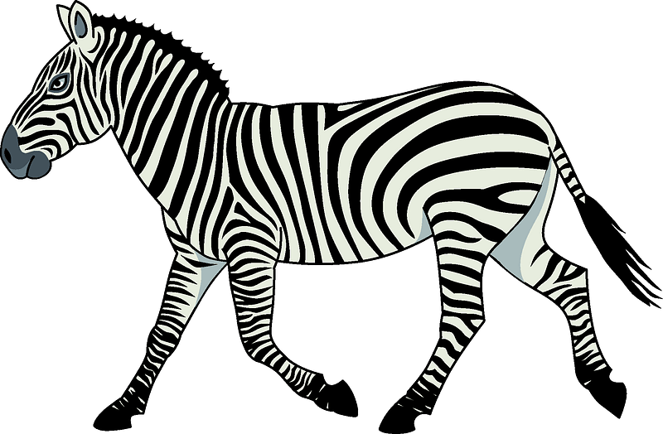
Did you get it right?

Slide 3

These animals do not live in the woodlands. I wonder where they live?

Slide 4
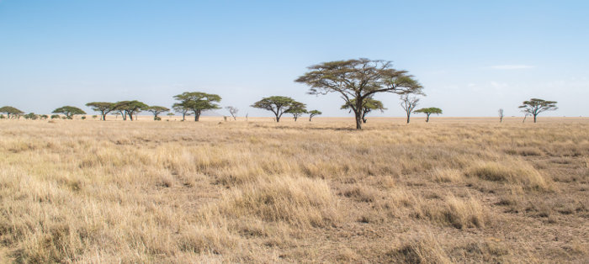
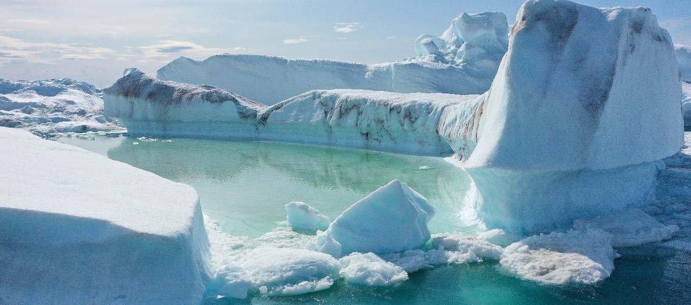

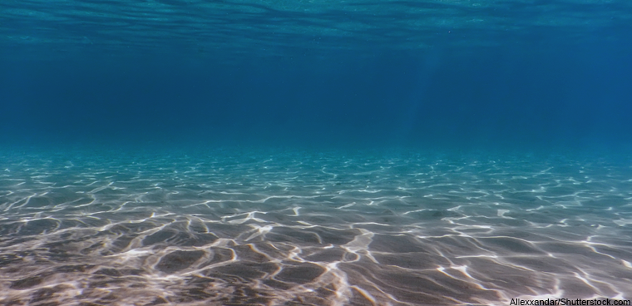

Slide 5
Look at these different animals? Can you think of different ways that we can sort them?

Slide 6

Animals with 4 legs
Animals with 2 legs
Animals with 4 legs
Can you think of a different way to sort the animals.
Animals with no legs

Slide 7
Can sort animals into different groups to help us identify an animal. When we sort animals this is called classification.
Lets look at another way we can classify animals.

Slide 8
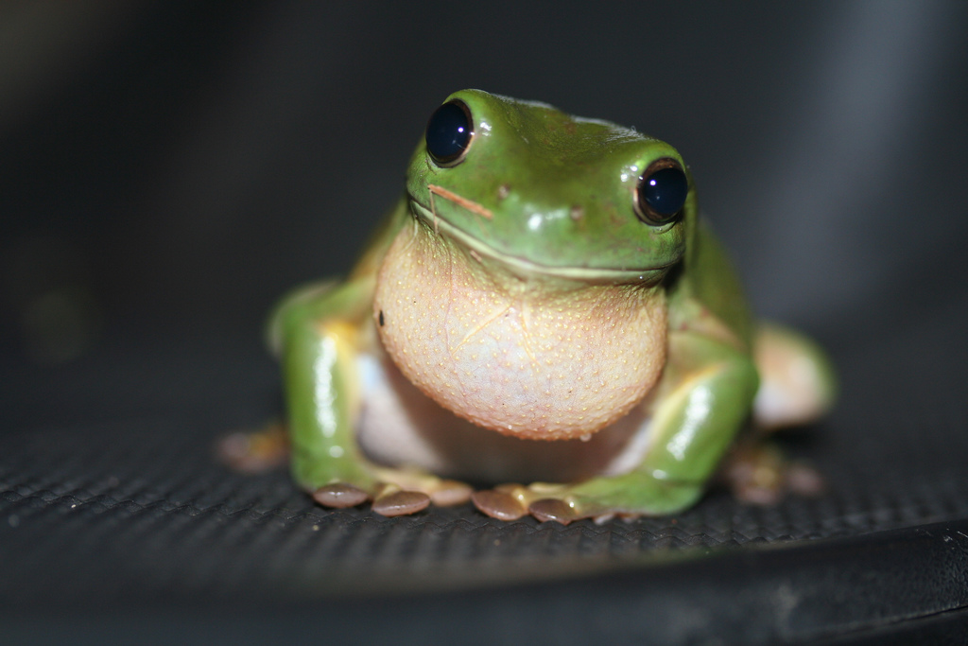
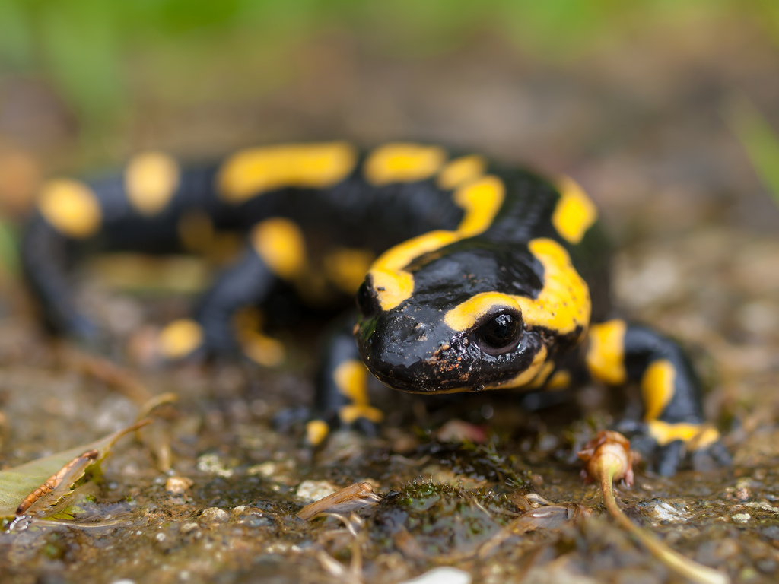
Amphibians
Note the similarities and differences between them.
frog
Amphibians live on land and in water. They lay their eggs in water.
salamander
Photo courtesy of wwarby, httpwwwflickrcomphotostopend (@flickr.com) - granted under creative commons licence - attribution

Slide 9
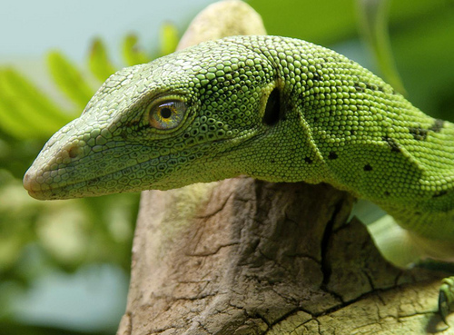
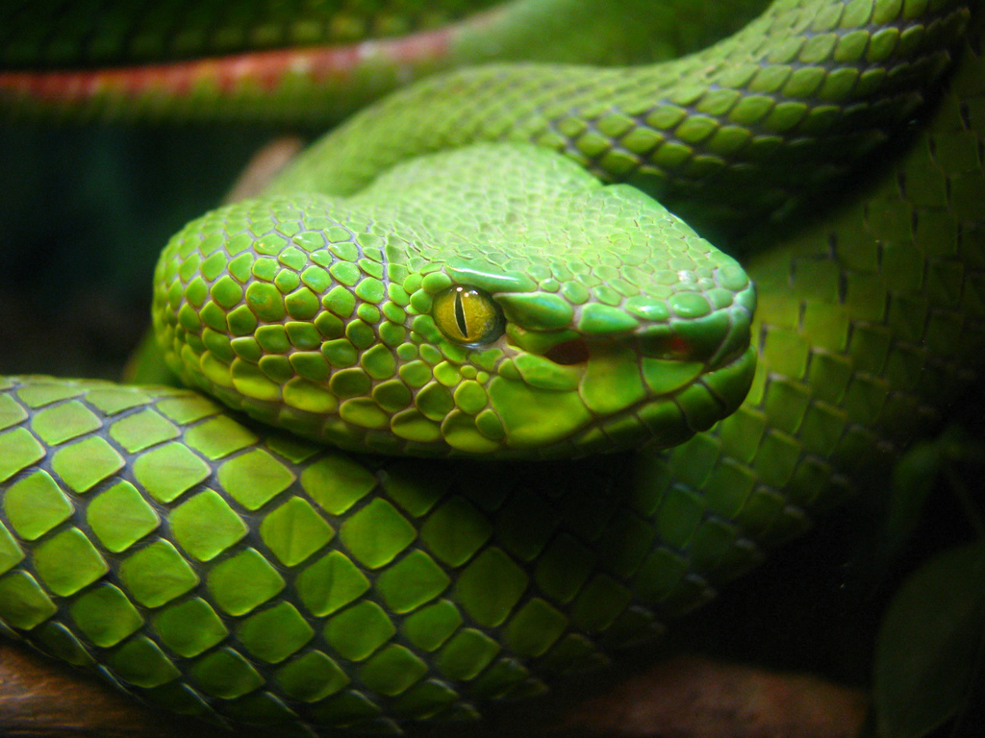
Reptiles
Note the similarities and differences between them.
lizard
Reptiles live in water and on land.
They have scales and are cold blooded. This means that they cannot keep warm by themselves and need to be in a warm place.
They lay their eggs on land.
snake
Photo courtesy of wwarby, httpwwwflickrcomphotostopend (@flickr.com) - granted under creative commons licence - attribution

Slide 10
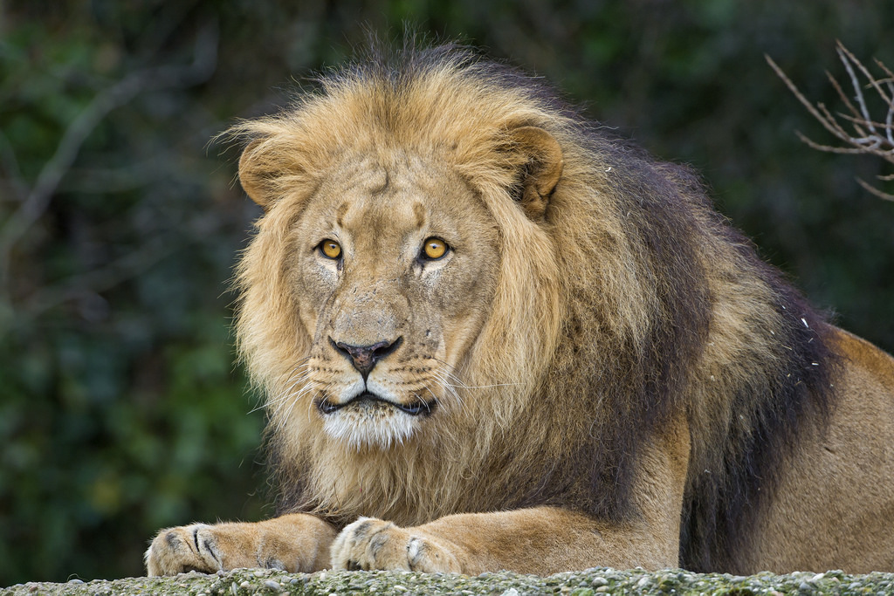
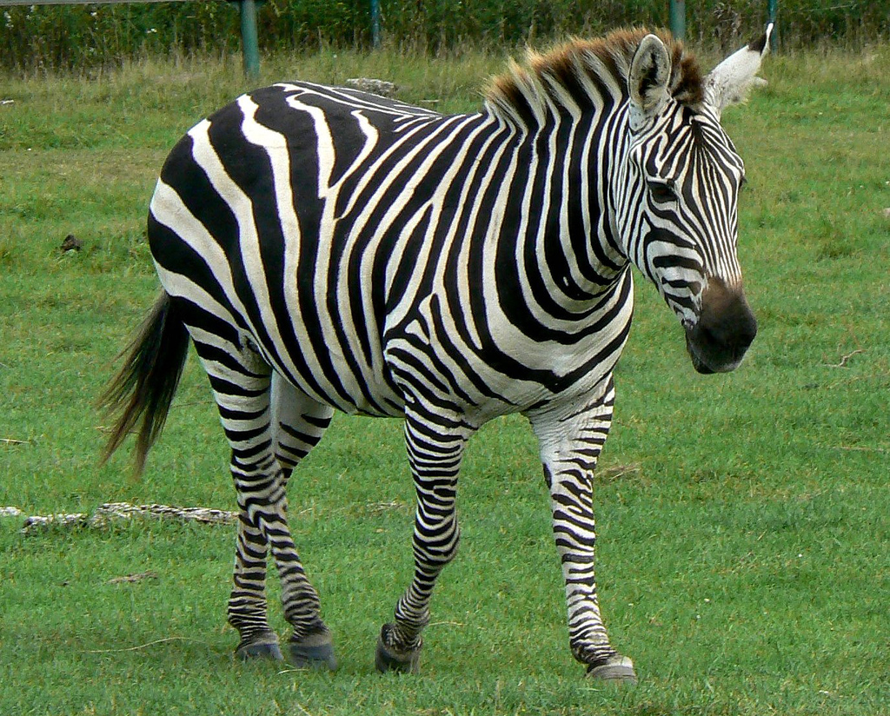
Mammals
Note the similarities and differences between them.
lion
Mammals usually have hair or fur.
Mammal babies are born alive.
The mothers feed their babies milk.
We are mammals.
zebra
Photo courtesy of vickispix, tambako(@flickr.com) - granted under creative commons licence - attribution

Slide 11
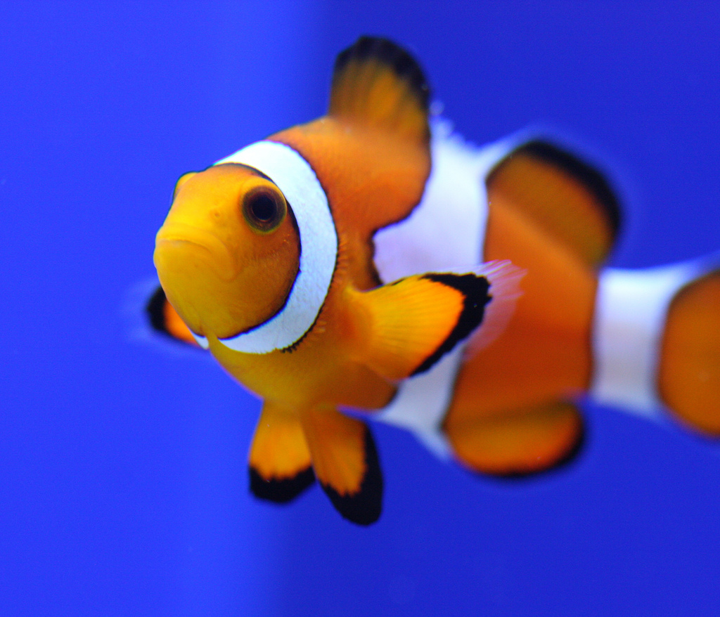
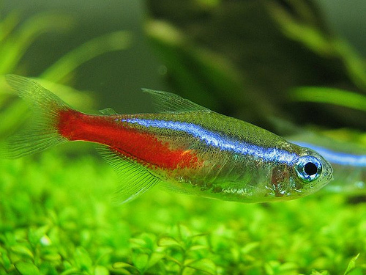
Fish
Note the similarities and differences between them.
Clown Fish
Fish live in water.
They have fins instead of legs and gills instead of lungs. They lay their eggs in water.
Neon Tetra
Photo courtesy of 24242453@N07, nathaninsandiego (@flickr.com) - granted under creative commons licence - attribution

Slide 12
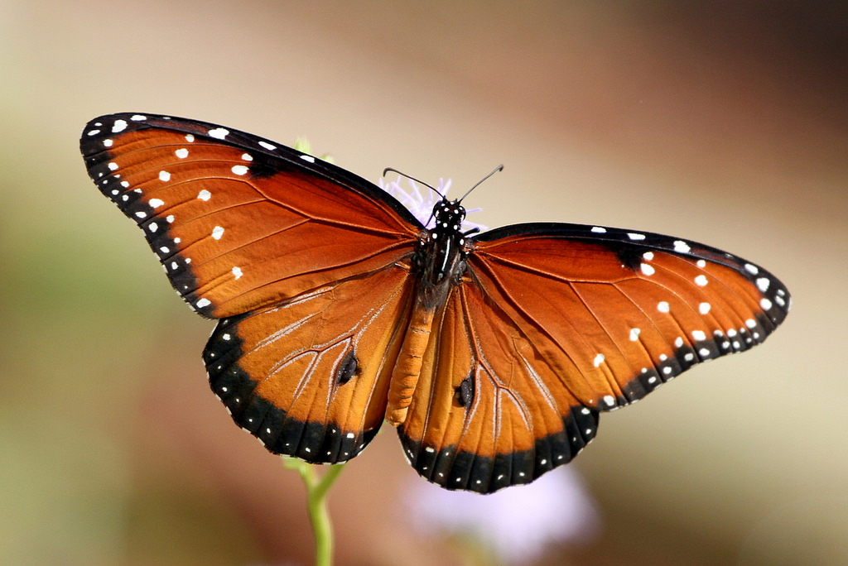
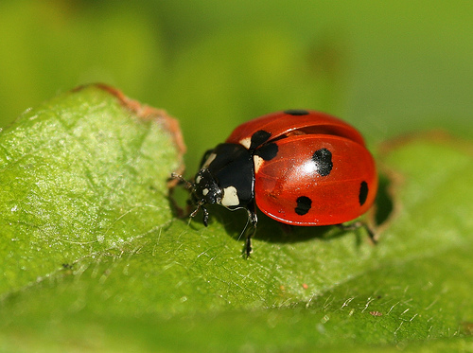
Insects
Note the similarities and differences between them.
butterfly
Insects have 6 legs.
Their bodies are made up of 3 parts. Some have wings.
They lay eggs.
ladybird
Photo courtesy of texaseagle, photos/rachel_s (@flickr.com) - granted under creative commons licence - attribution

Slide 13
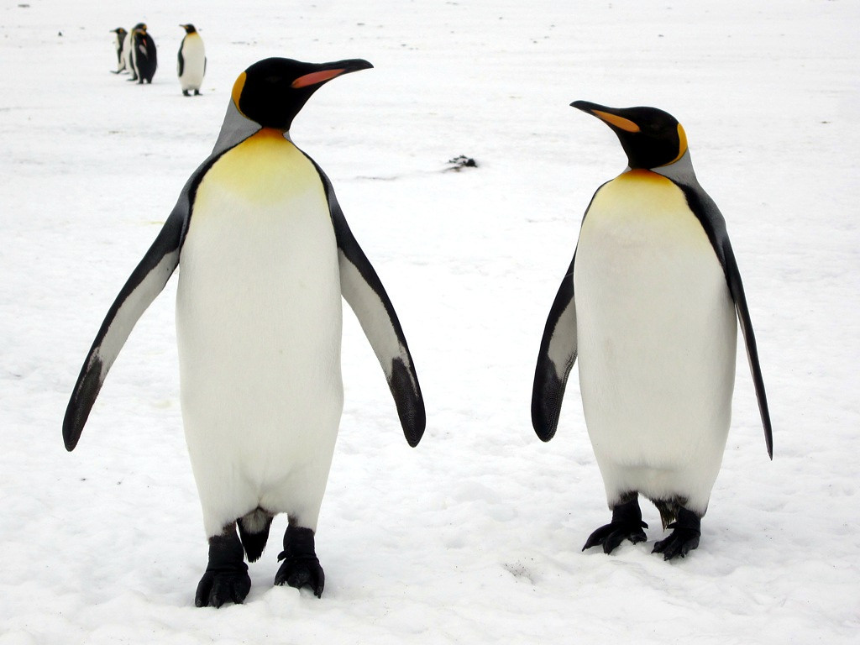
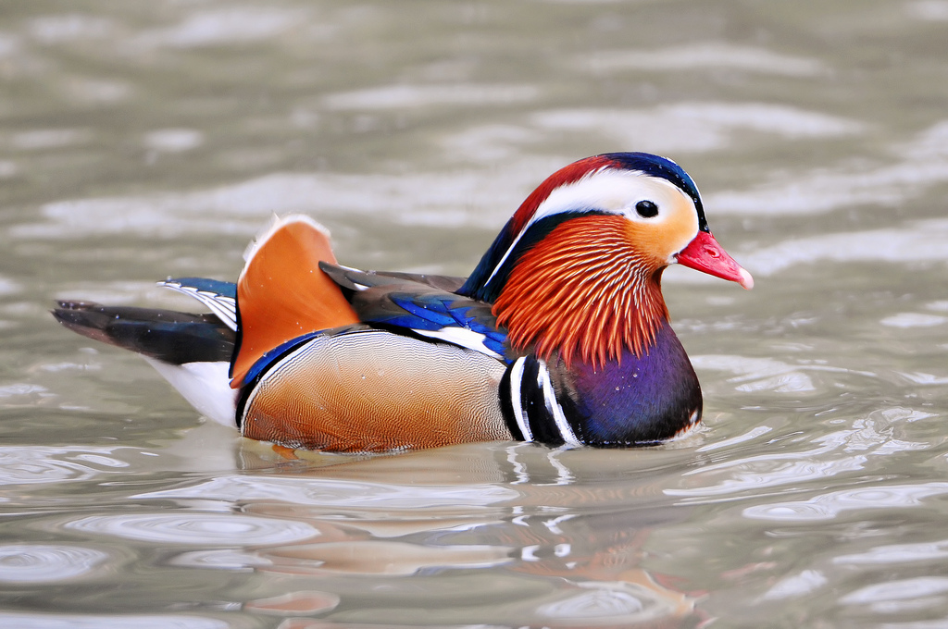
Birds
Note the similarities and differences between them.
penguins
Birds have a beak, wings, feathers and 2 legs. They lay eggs.
Mandarin Duck
Photo courtesy of davidstanleytravel, tambako (@flickr.com) - granted under creative commons licence - attribution

Slide 14
https://www.bbc.co.uk/bitesize/topics/zn22pv4/articles/z3nbcwx
Watch this clip on classification.

