Slide 1
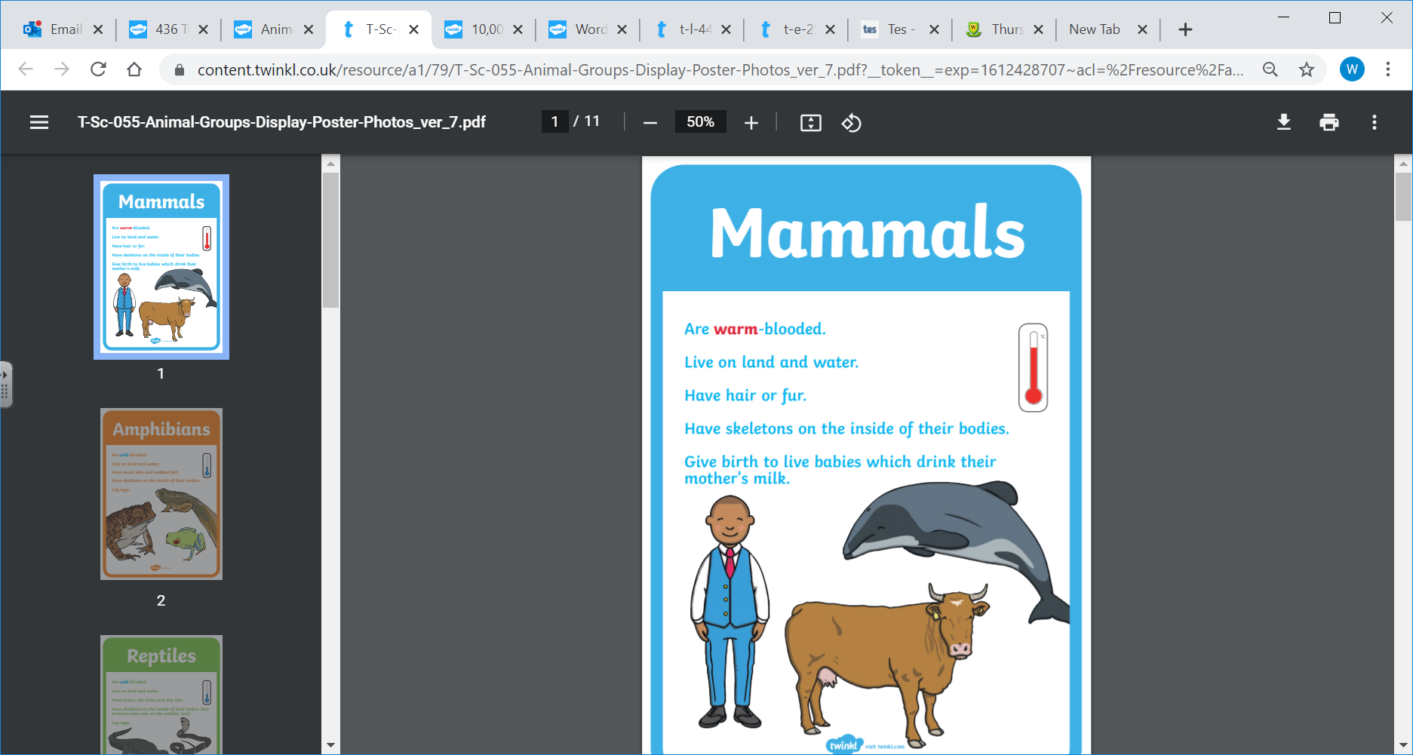

Slide 2
Last week we looked at birds and their different features.
Can you remember how we classify a bird?
Wings
Feathers
Beak
This week we are going to explore mammals and see if we can sort the woodland animals into mammals and not mammals.

Slide 3
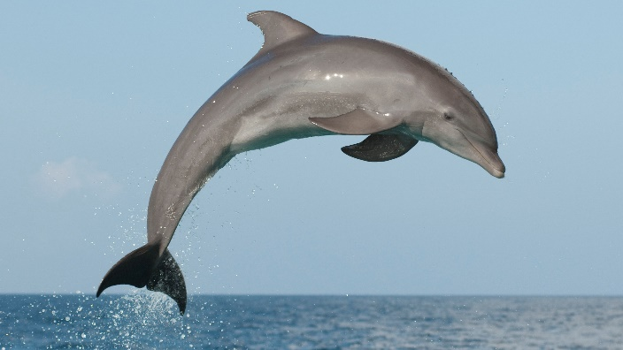
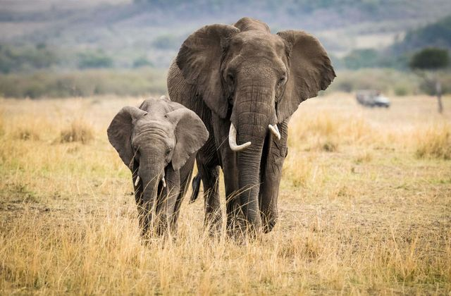
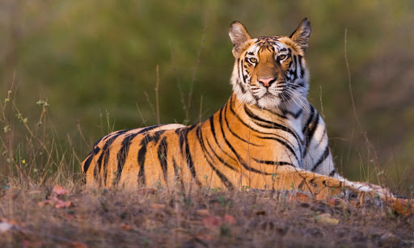
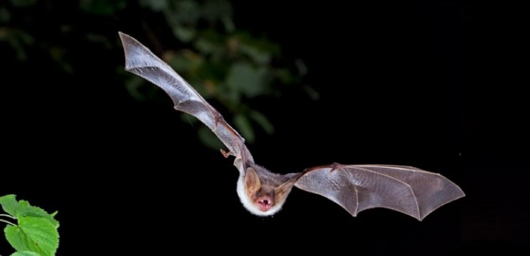
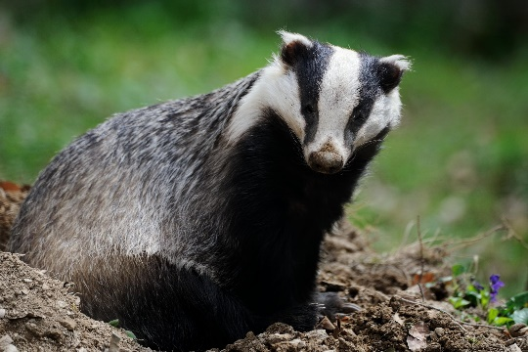
Here are some mammals. What is the same, what is different? Can you name all the animals?
Different: Some of these animals live in water and some of these animals have wings? I wonder what makes them all the same?

Slide 4
Watch this video clip about mammals
https://www.bbc.co.uk/bitesize/topics/z6882hv/articles/zp92xnb
Why not try the quiz.
What did you find out? Can you tell me three facts about mammals?

Slide 5
Task: This week see how many mammals you can spot, I have given you a checklist to help you. You might have some mammals in your house. How many can you find?

Slide 6


