Slide 1
Woodland animals and their habitats.

Slide 2
We are going to look at animals that live in a woodland habitat.
A habitat is where an animal will make its home.
Lots of animals live in the woodlands, but what is a woodland?
A woodland is a large area that is covered with trees.

Slide 3
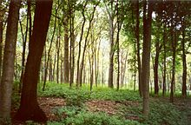
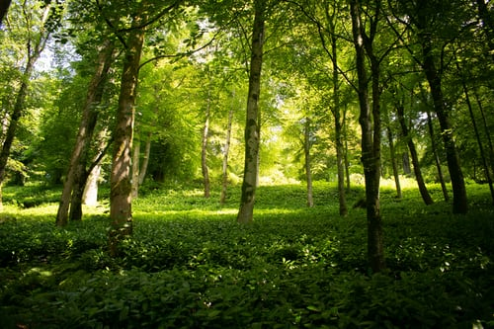
What does a woodland look like?
https://www.bbc.co.uk/bitesize/topics/zx882hv/articles/zc42xnb

Slide 4
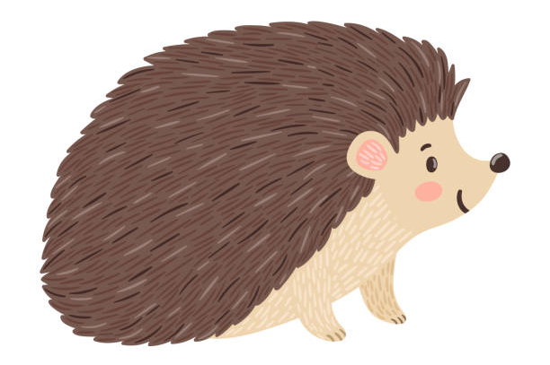
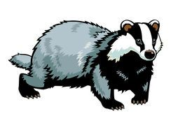
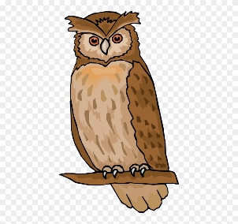
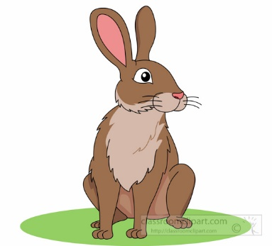
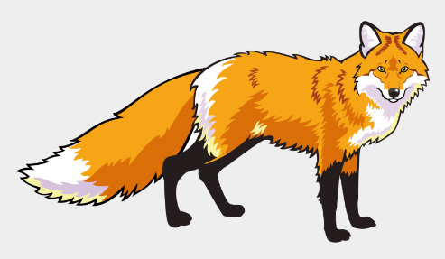
In the United Kingdom we have lots of animals that live in the woodlands.
Can you name some woodland animals that we can find in the United Kingdom?
Which animals are mammals?

Slide 5
Next we are going to look at woodland animals that live in different parts of the United Kingdom.
Can you name the 4 countries of the United Kingdom?

Slide 6
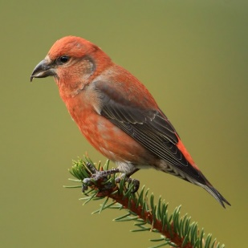
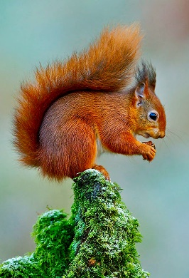
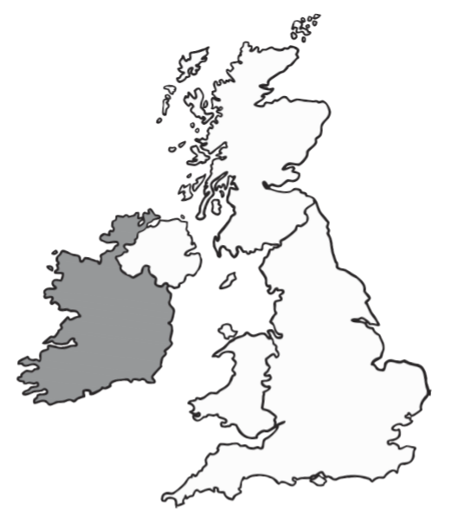
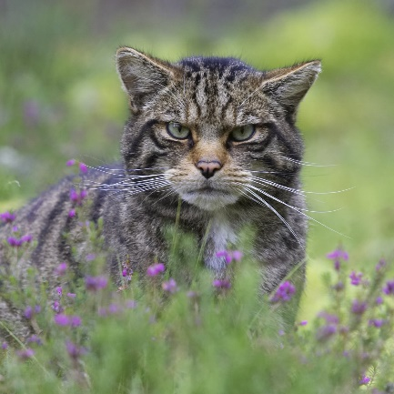
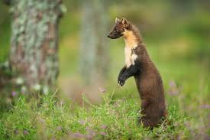
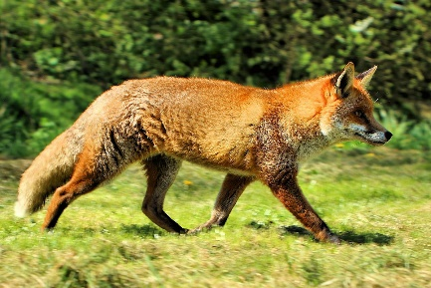
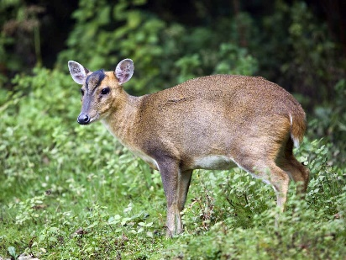
Scotland
Northern Ireland
Wales
England
Some of these animals may also be found in other parts of the country.

Slide 7
Muntjac Roe
Red squirrel
Scottish wild cat
Scottish Crossbill
Pine Marten
Red Fox
Can you tell which ones are mammals?

Slide 8
You might like to research some interesting facts about the animals that we have looked at today or explore more animals that live in the different countries and create a fact file
Scotland wildlife: https://scottishwildlifetrust.org.uk/scotlands-wildlife/species-finder/
Ireland wildlife: https://irelandswildlife.com/species-profiles/
Wales wildlife: http://www.bbc.co.uk/earth/story/20160229-celebrating-the-wonderful-wildlife-of-wales
England wildlife: https://britishwildlifecentre.co.uk/planyourvisit/animals/

Slide 9
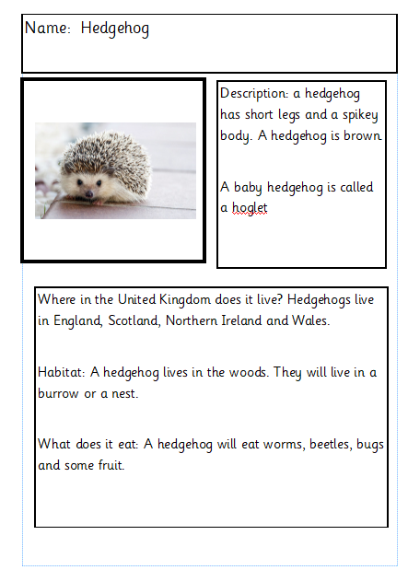
Name of the animal
Write a short description about your animal. What do they look like?
What is the animal called as a baby?
Where in do they live in the United Kingdom
What is the animals habitat. Where does it make its home. Tree? Nest? Burrow?
What do they eat?
An interesting fact.

Slide 10
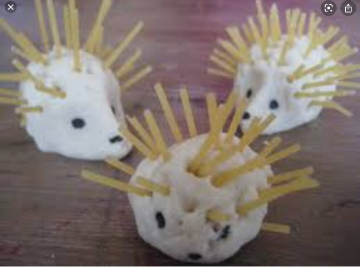
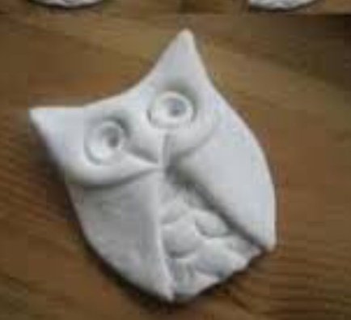
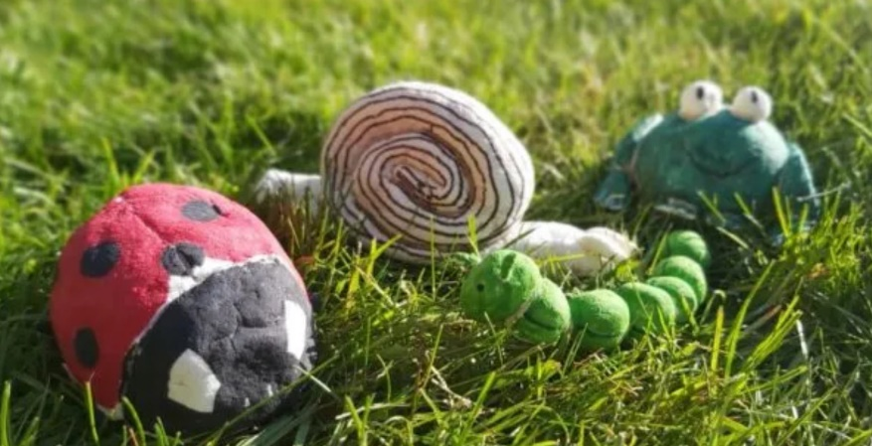
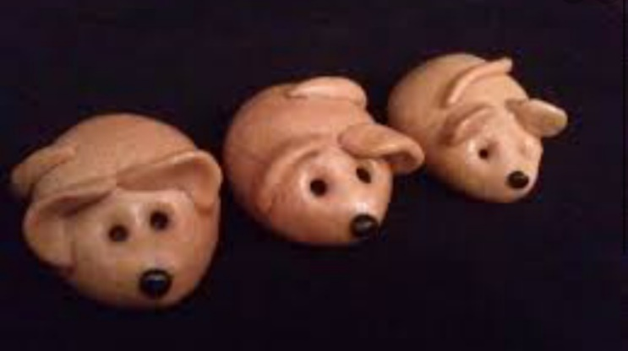
You might like to make a woodland animal with salt dough.
Here is the recipe:
1 cup flour
½ cup salt
½ cup water.
Mix all the ingredients together.

