Slide 1

Measuring Length and Height
We are going to look at the words longer and shorter today. Can you find things that are long and short?

Slide 2
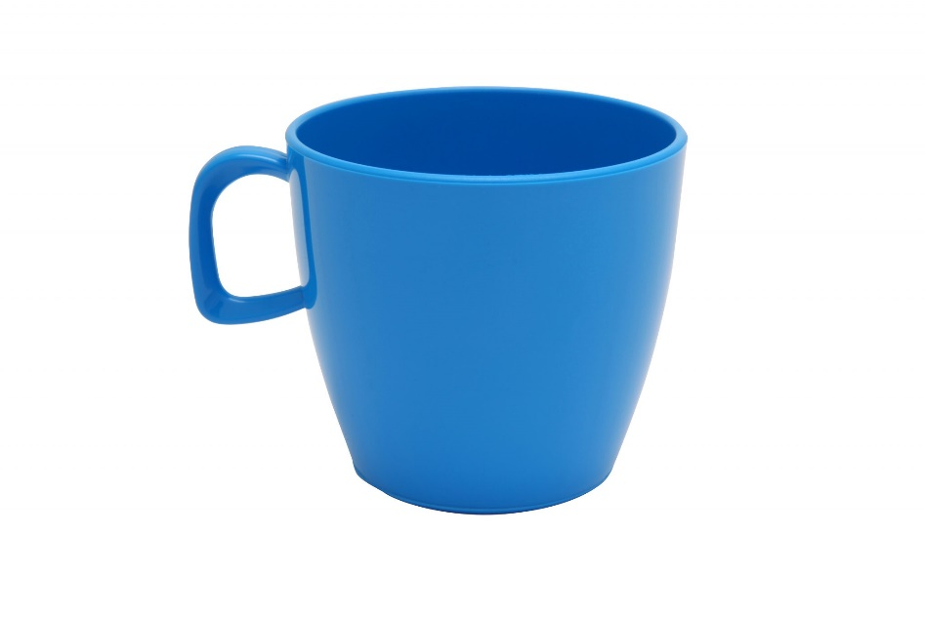
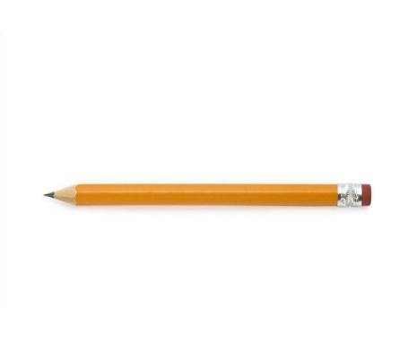


Which pencil is longer?
Which cup is shorter?

Slide 3
Did you get it right?

Slide 4



Body Parts
Find something that is longer than your hand.
Find something that is shorter than your hand.

Slide 5
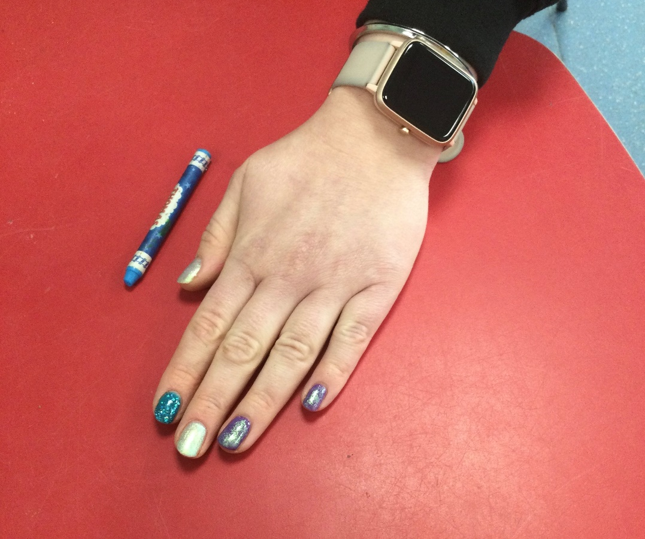
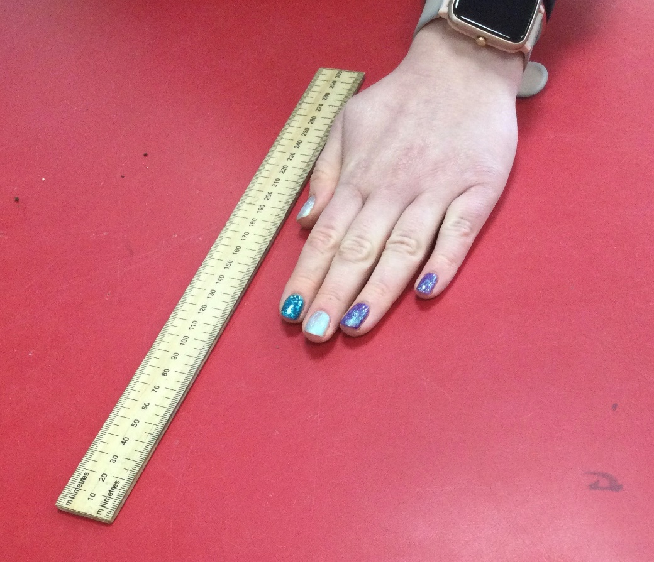
The crayon is shorter than my hand
The ruler is longer than my hand

Slide 6

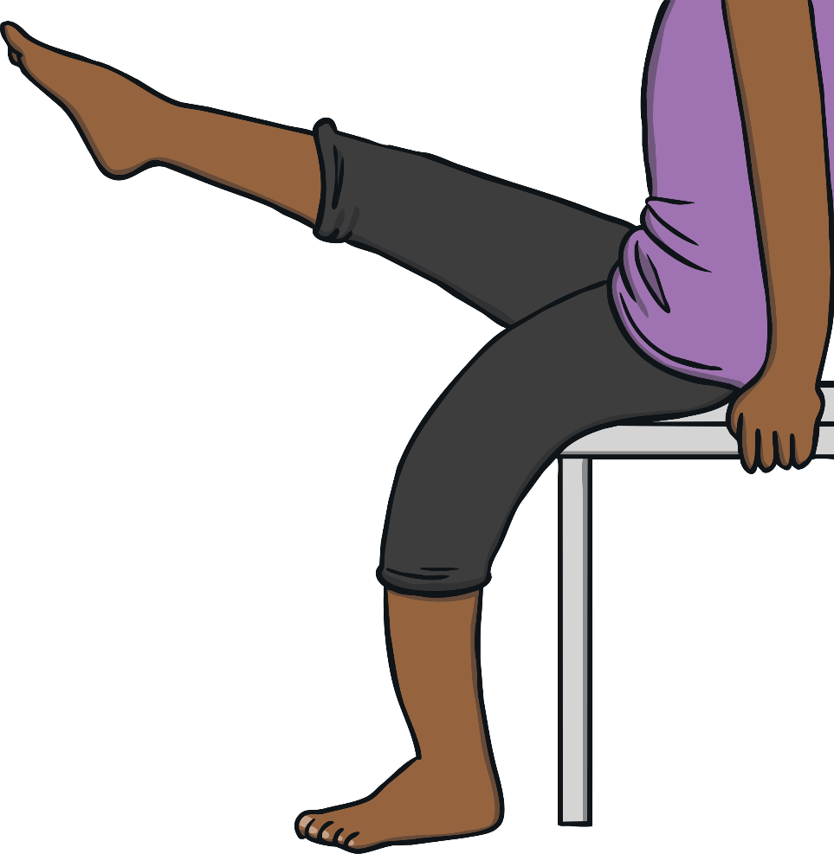
Body Parts
Find something that is longer than your foot.
Find something that is shorter than your foot.

Slide 7
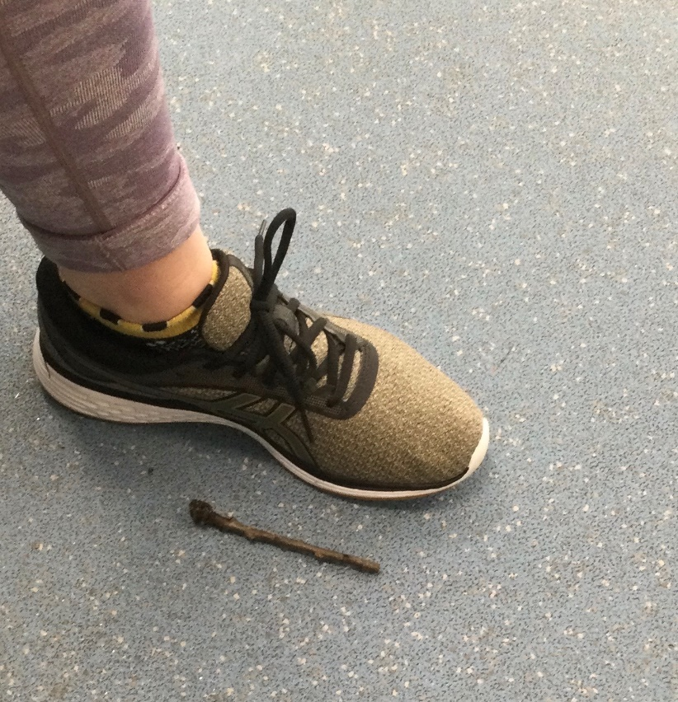
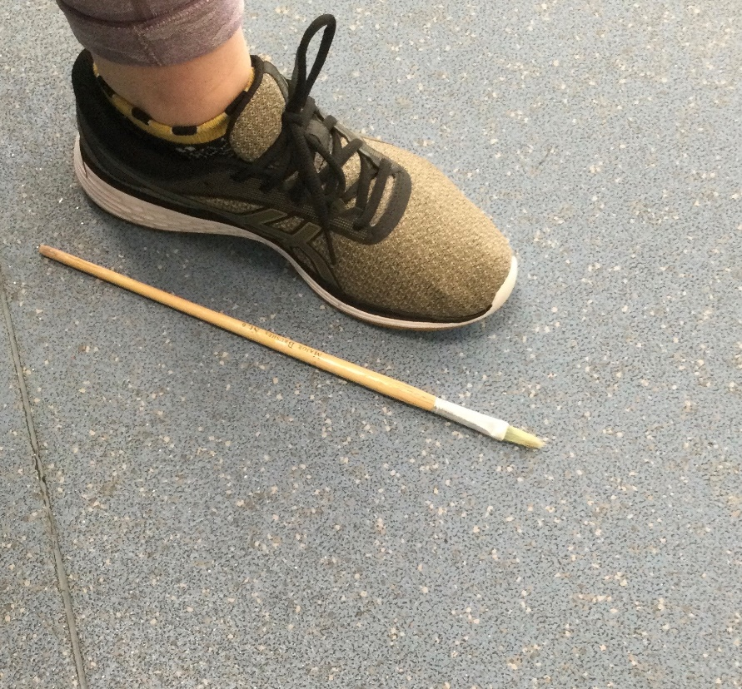
The stick is shorter than my foot.
The paintbrush is longer than my foot.
Now you try. Can you find items at home that are shorter or longer?

Slide 8
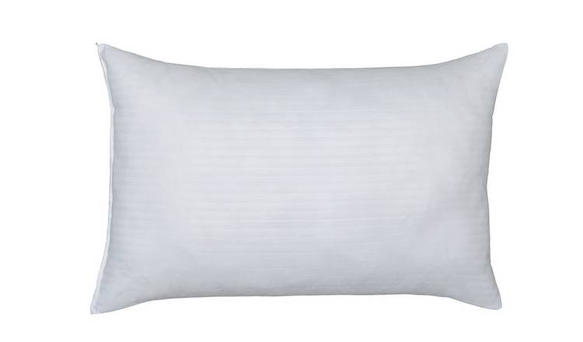
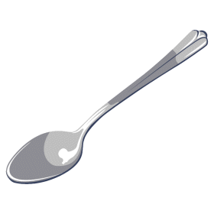
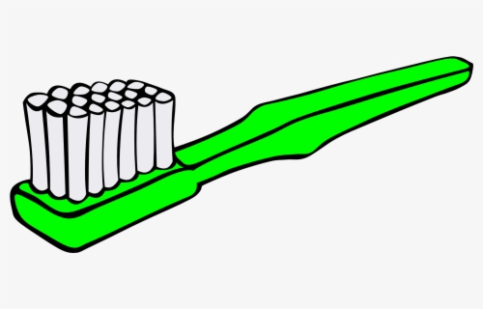
Here are some items to find at home.
Are they longer or shorter than your hand?
Are they longer or shorter than your foot?

