Slide 1
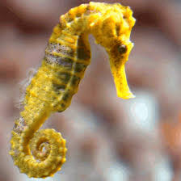
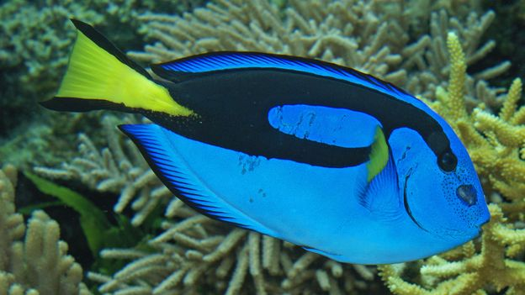
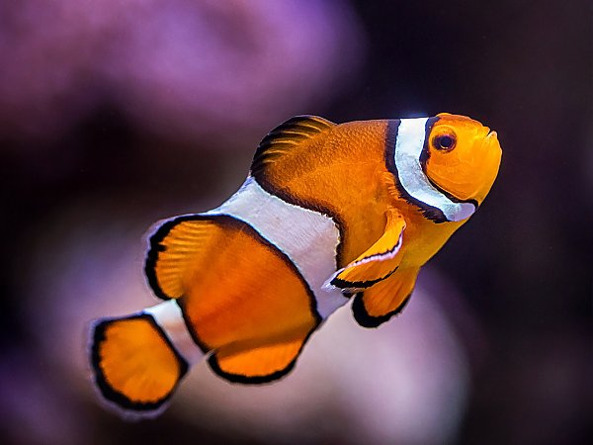
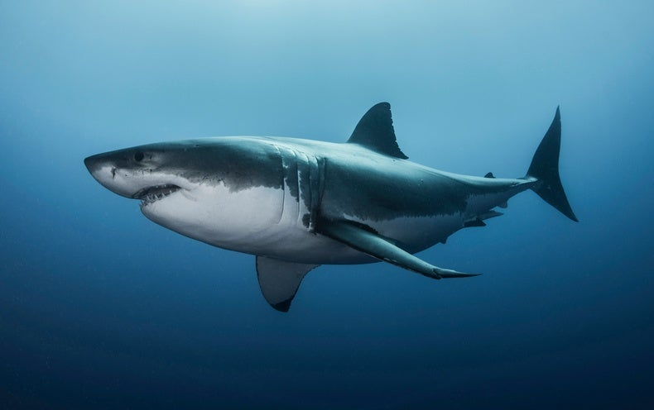
Fish

Slide 2
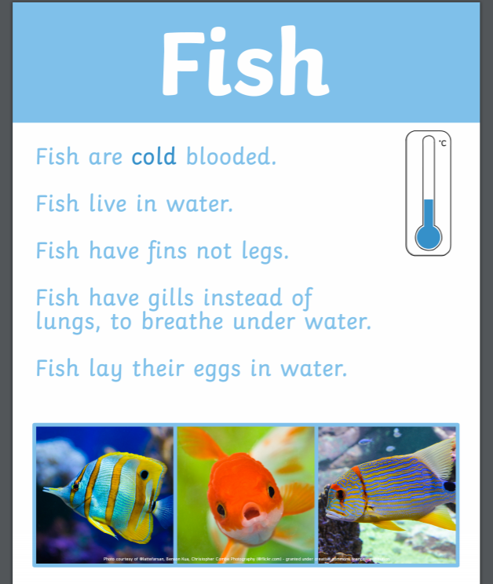
We are going to look at classifying fish.

Slide 3
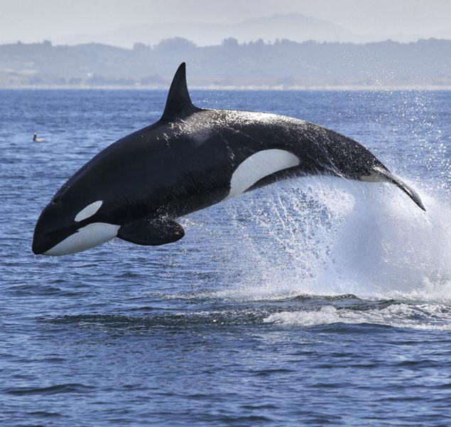
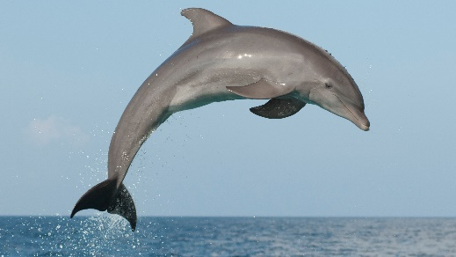
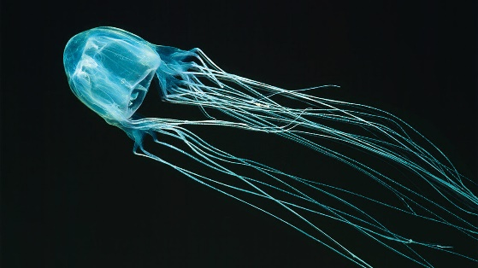
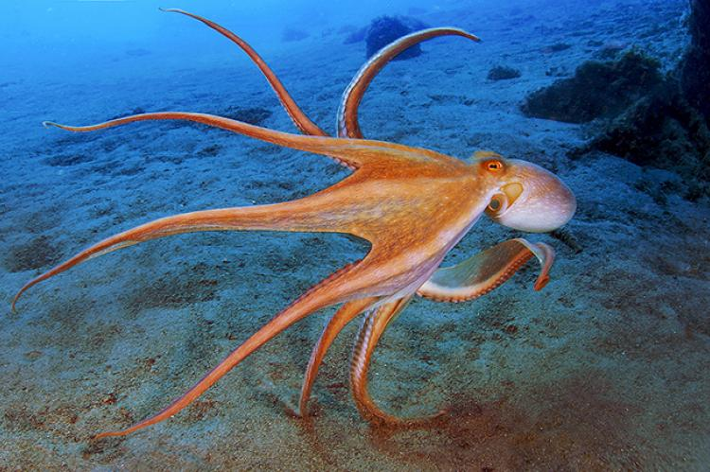
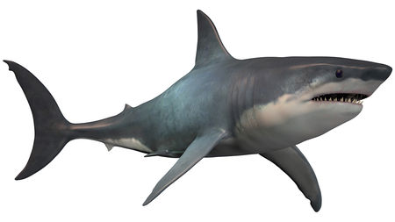
Not all animals that live in the sea are fish. Which animals are not a fish?

Slide 4
These animal are mammals.
These animals are invertebrates. This means they don’t have a back bone. Lots of animals don’t have a back bone how many can you research?

Slide 5
Vertebrate
An animal with a backbone
Invertebrate
An animal without a backbone

Slide 6


