Slide 1
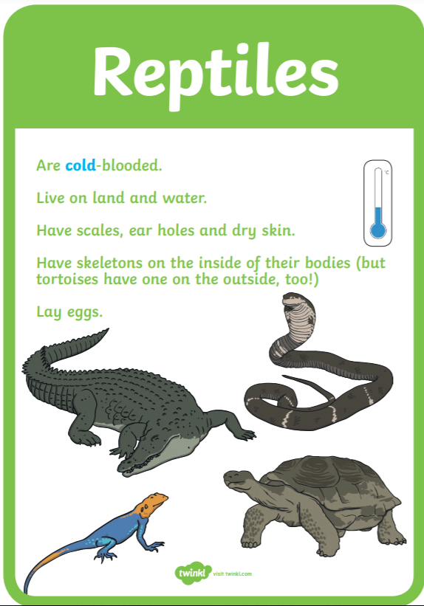
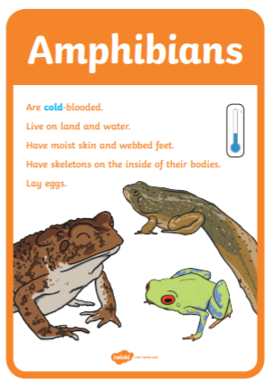

Slide 2
What is the difference between a reptile and an amphibian?
We are going to look at the similarities and the differences between a reptile and an amphibian and how we can tell them apart.
Below are two clips that will help our thinking.
What is a reptile:
https://www.bbc.co.uk/bitesize/topics/z6882hv/articles/zp9pfg8
What is an amphibian: https://www.bbc.co.uk/bitesize/topics/z6882hv/articles/zc6br82

Slide 3
Similarities: Reptiles and amphibians both lay eggs. They can both live on land or water.
Differences:
We know that reptiles have dry scaly skin and amphibians have wet shiny skin.
Amphibians have webbed feet.
Now can you sort some animals into reptiles and amphibians.

Slide 4
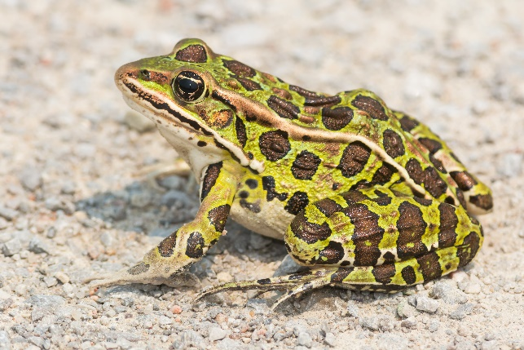
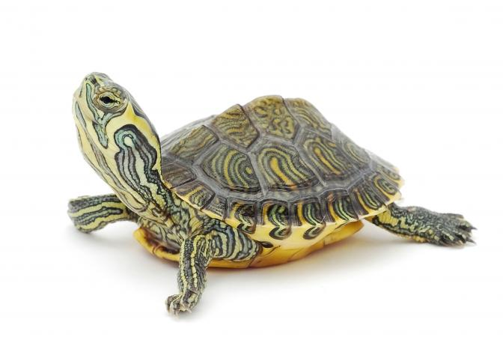
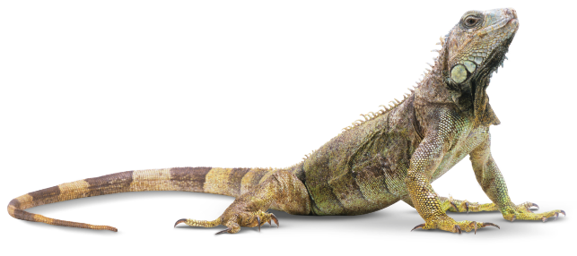
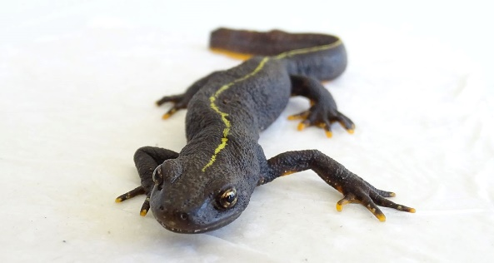
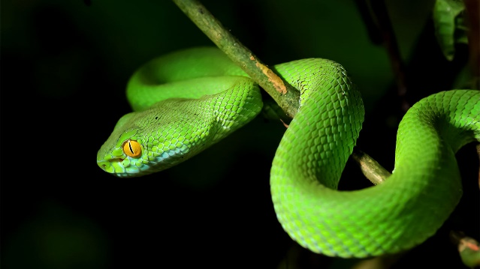
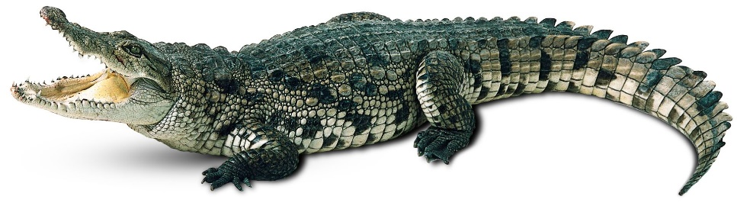
Can you sort the animals into amphibian and reptiles.

Slide 5
Reptile
Amphibians
Can you name the animals?

Slide 6

Frog
Newt
Turtle
Lizard
Snakes
Crocodile

Slide 7
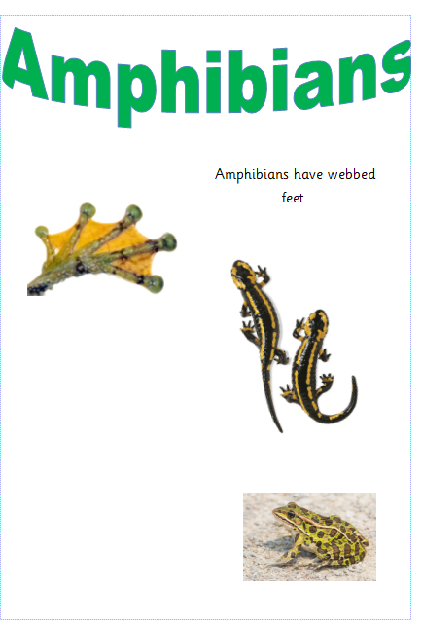
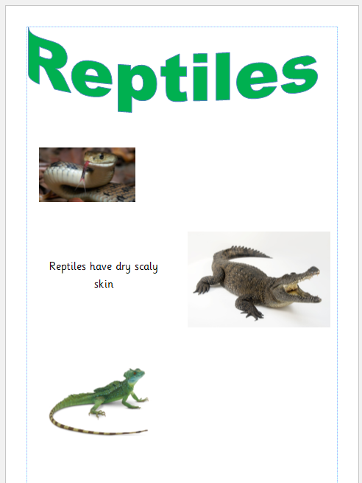
Task: to make a poster to identify either an reptile or amphibian.
You might like to research or look at some pictures of reptiles and amphibians in the United Kingdom for your poster.
Reptiles: https://www.wildlifetrusts.org/where_to_see_reptiles
Amphibians: https://www.wwt.org.uk/discover-wetlands/wetland-wildlife/amphibians/#

Slide 8

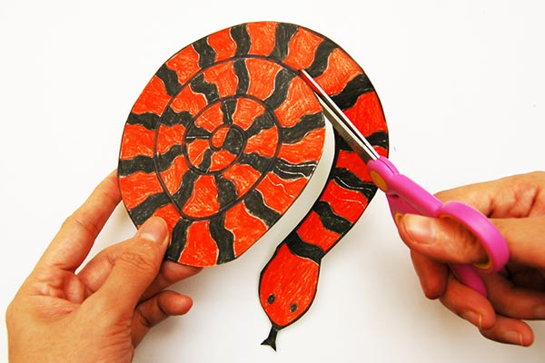
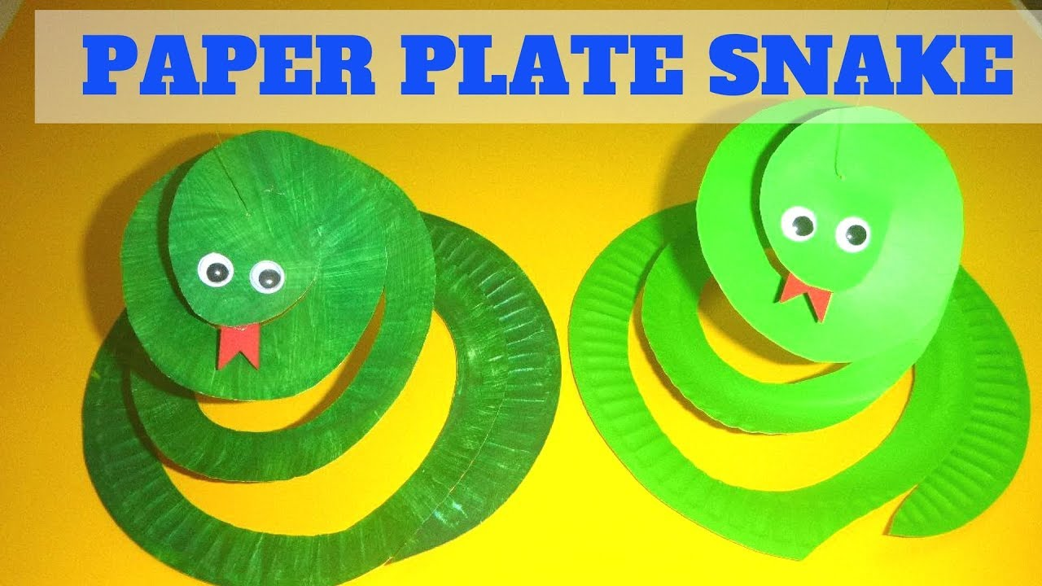
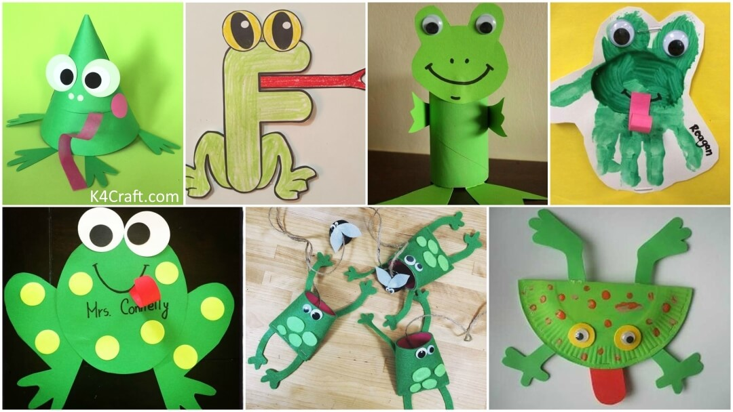
Just for fun

