Slide 1
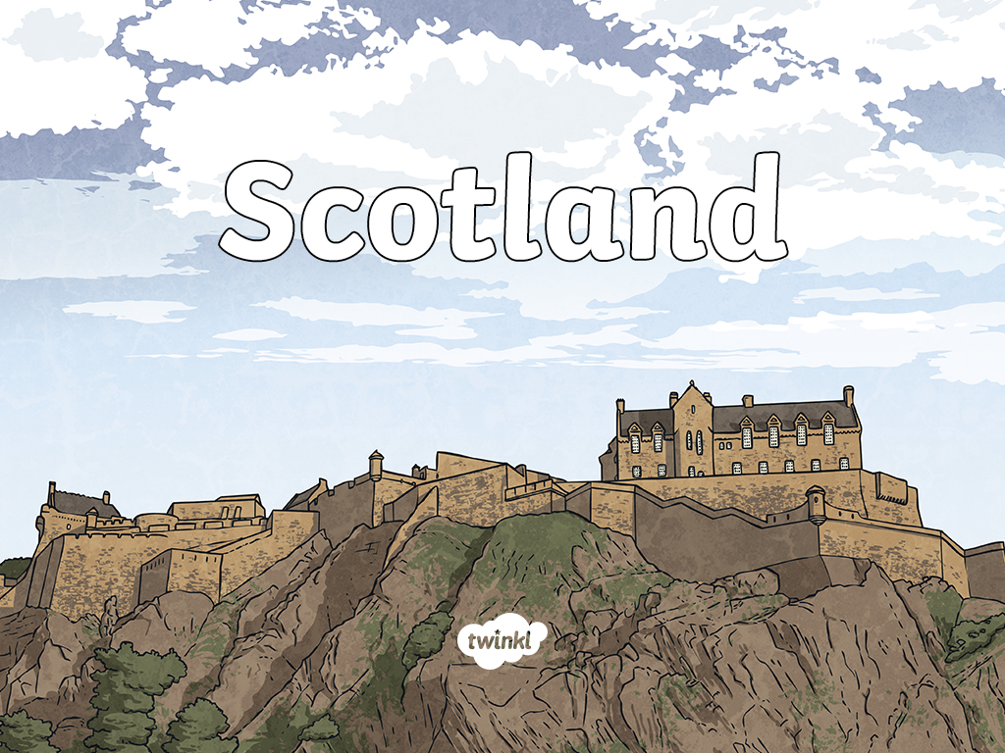

Slide 2
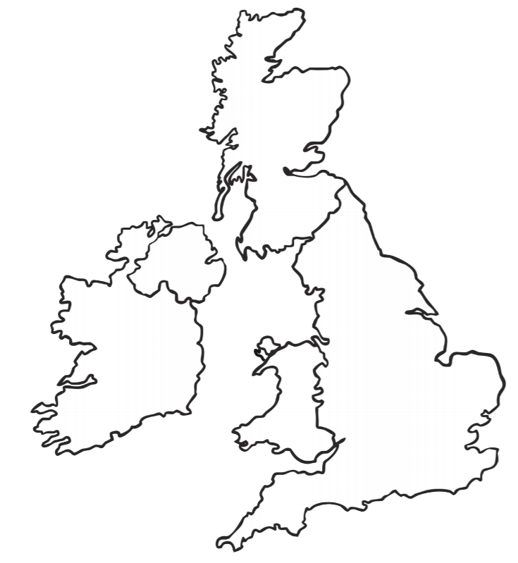
Can you remember where Scotland is?

Slide 3
There it is? Did you get it right?
Lets have a look at some landmarks in Scotland

Slide 4
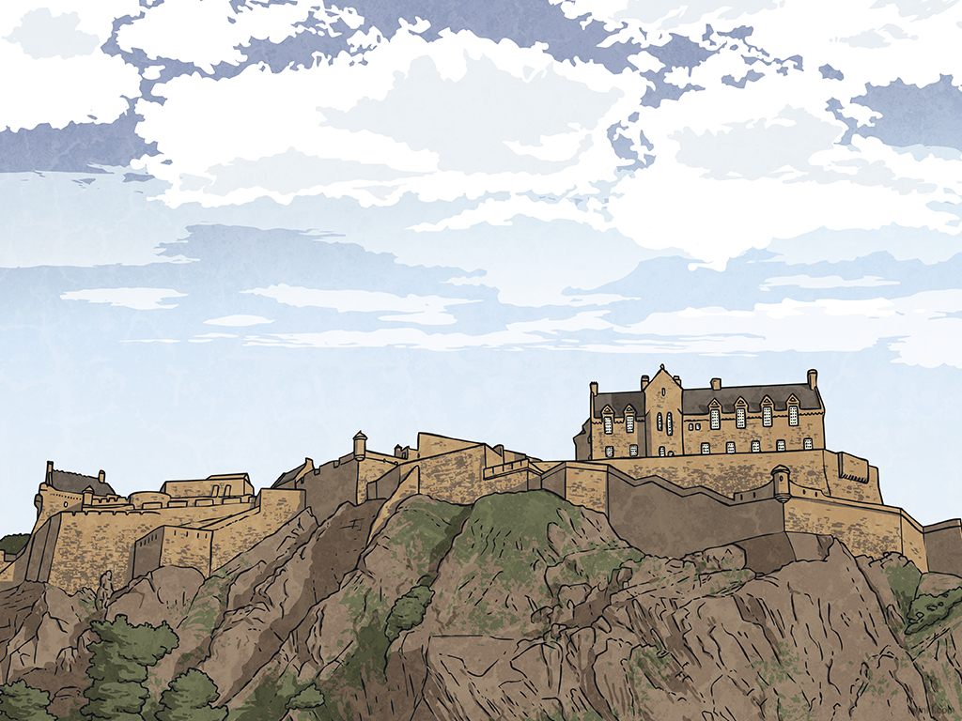
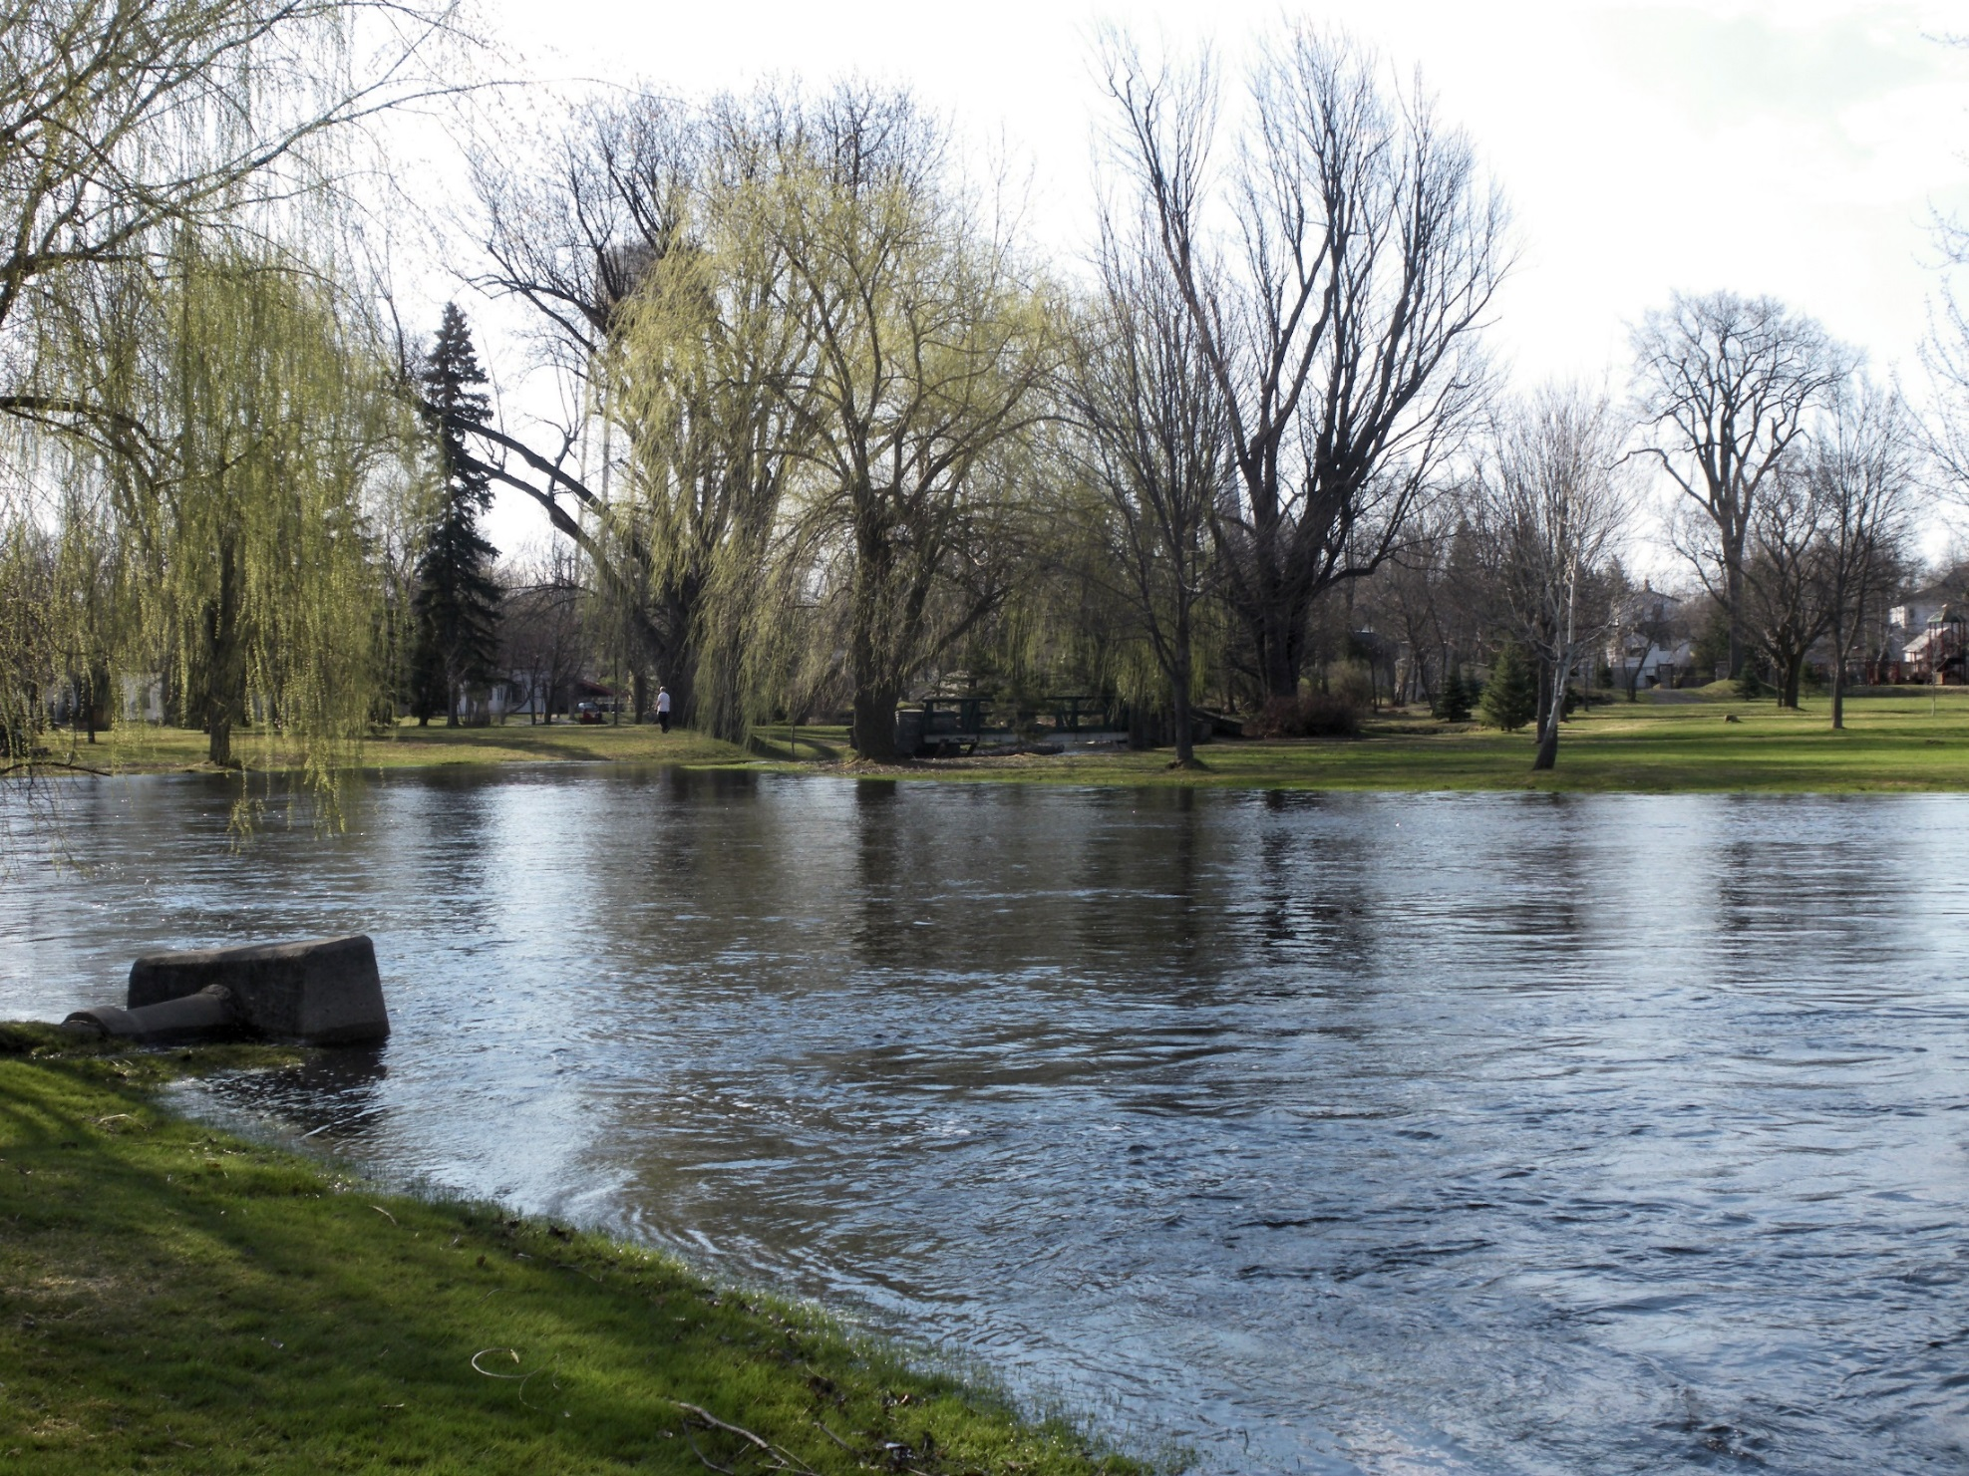
River Tay
This is the longest river in Scotland and the seventh longest in the United Kingdom.
Photo courtesy of Gord Bell (@flickr.com) - granted under creative commons licence - attribution

Slide 5
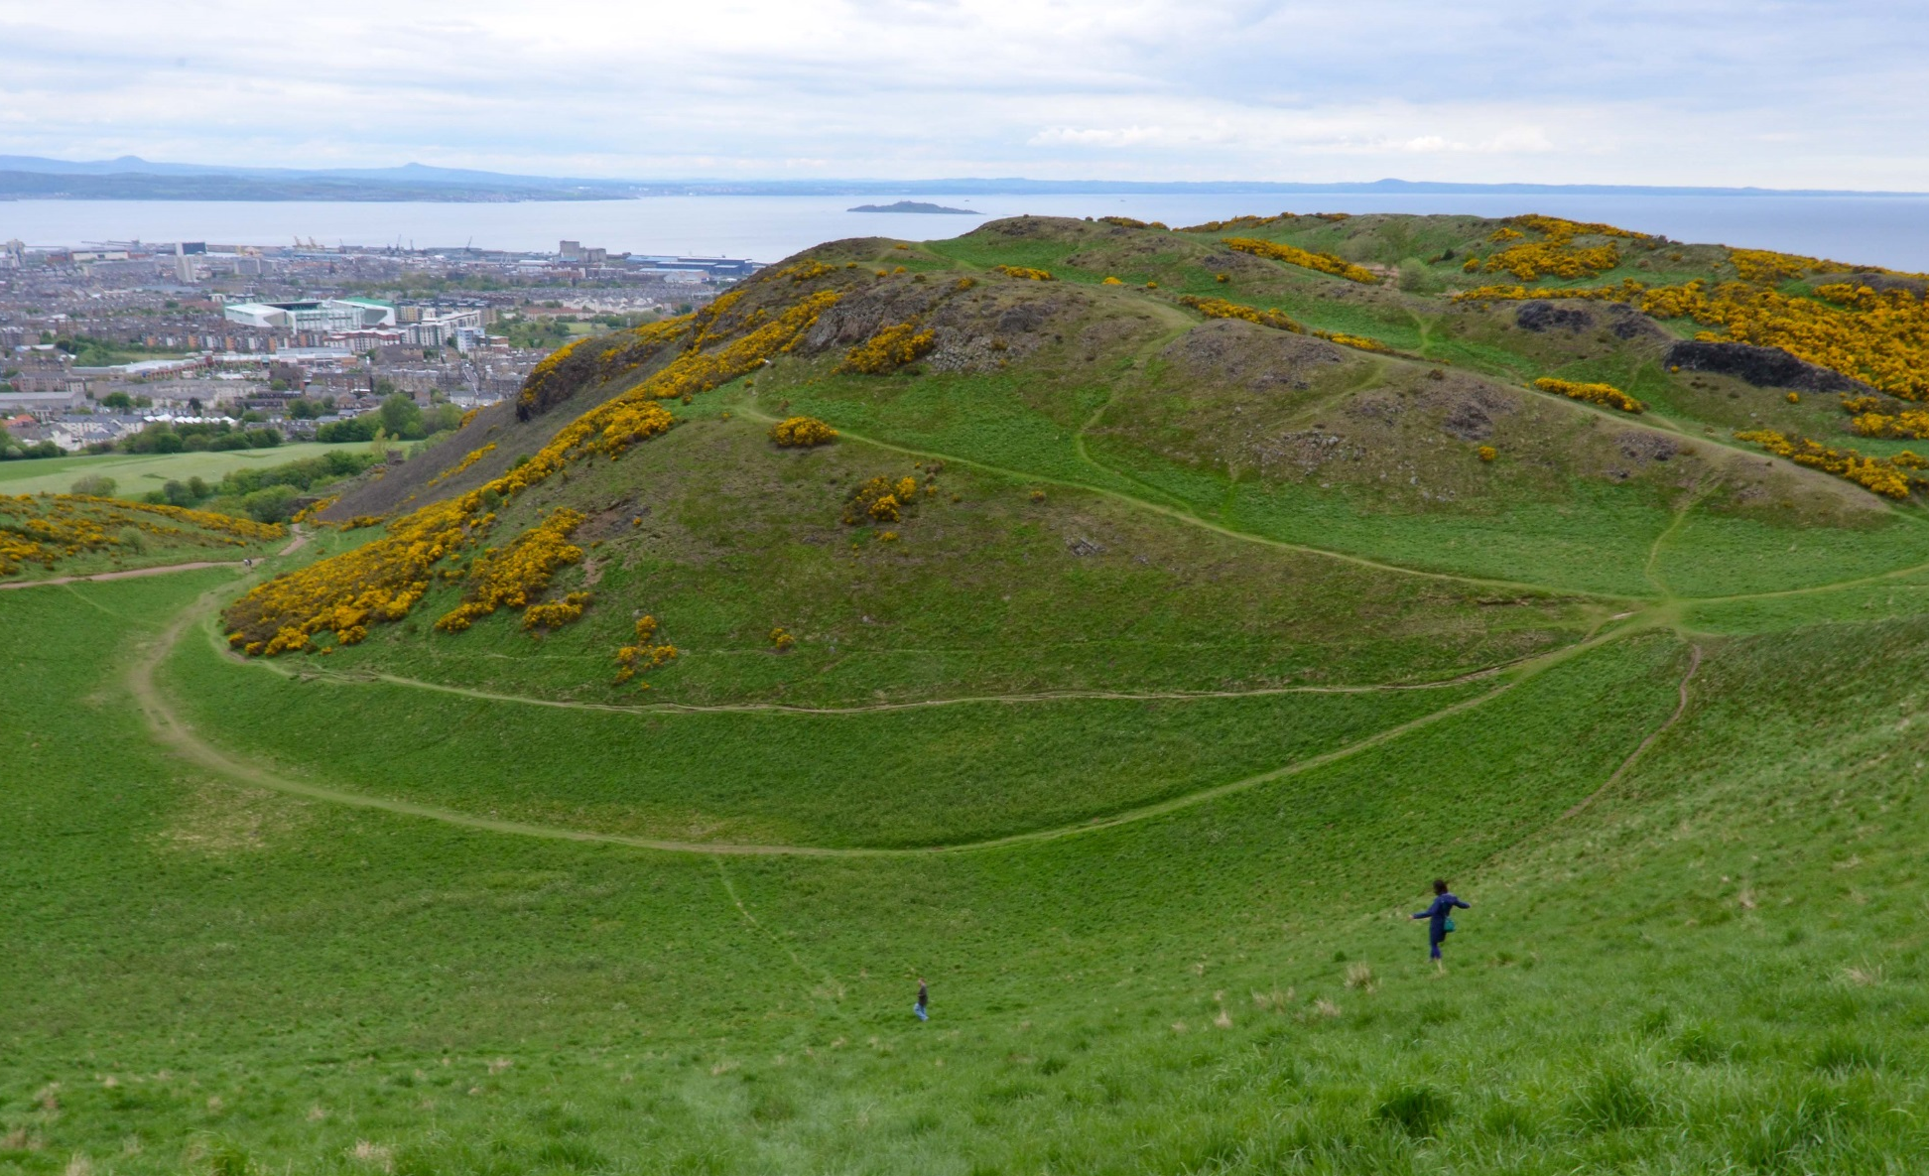
Arthur’s Seat
This is the main peak in a group of hills, situated in the centre of Edinburgh.
Photo courtesy of iriskh (@flickr.com) - granted under creative commons licence - attribution

Slide 6
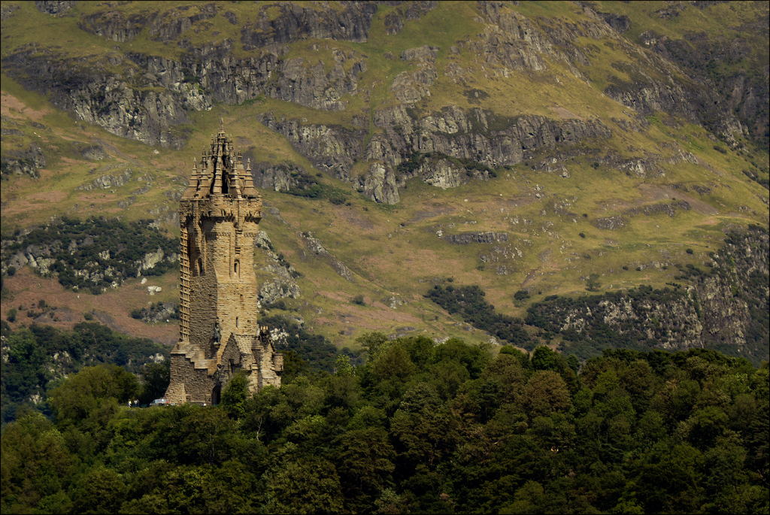
National Wallace Monument
This is a tower in Stirling, to commemorate Sir William Wallace,
a 13th-century Scottish hero.
Photo courtesy of dun_deagh (@flickr.com) - granted under creative commons licence - attribution

Slide 7
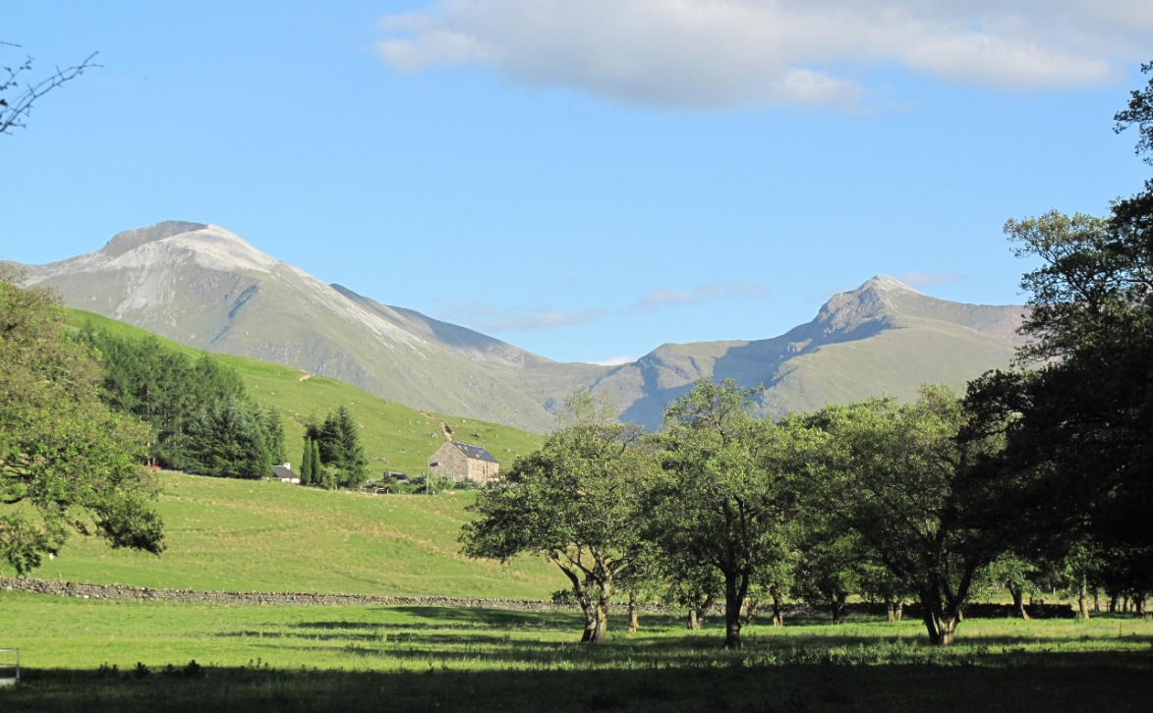
Ben Nevis
Located within the Grampian Mountains,
Ben Nevis is the tallest mountain in the British Isles.
Photo courtesy of ozimanndias8 (@flickr.com) - granted under creative commons licence - attribution

Slide 8
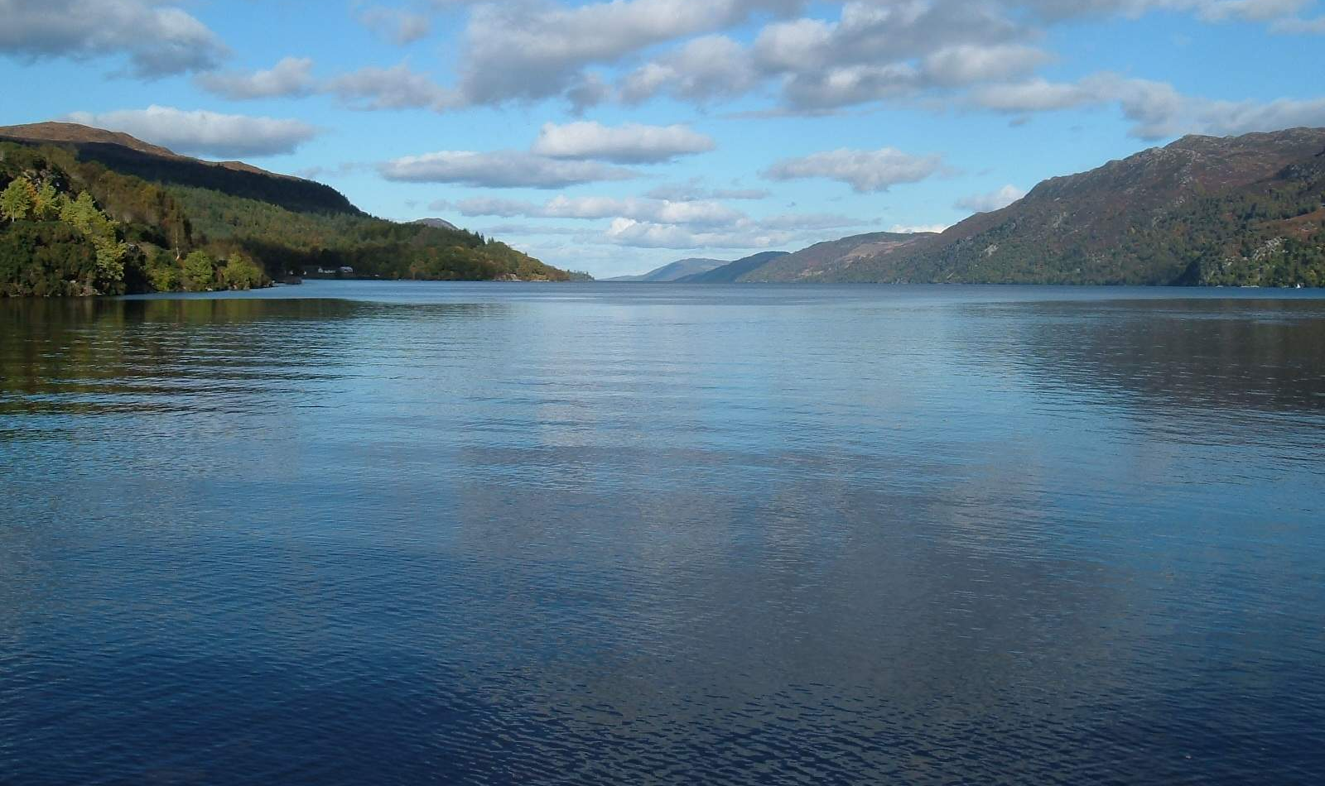
Loch Ness
Loch Ness is a huge, deep, freshwater loch in the Highlands. Loch Ness is famous for the alleged sightings of ‘The Loch Ness Monster’ (‘Nessie’ for short), a large creature which some people believe lives in the Loch.
Photo courtesy of conner395 (@flickr.com) - granted under creative commons licence - attribution

Slide 9
The capital city of Scotland is Edinburgh
Edinburgh

Slide 10
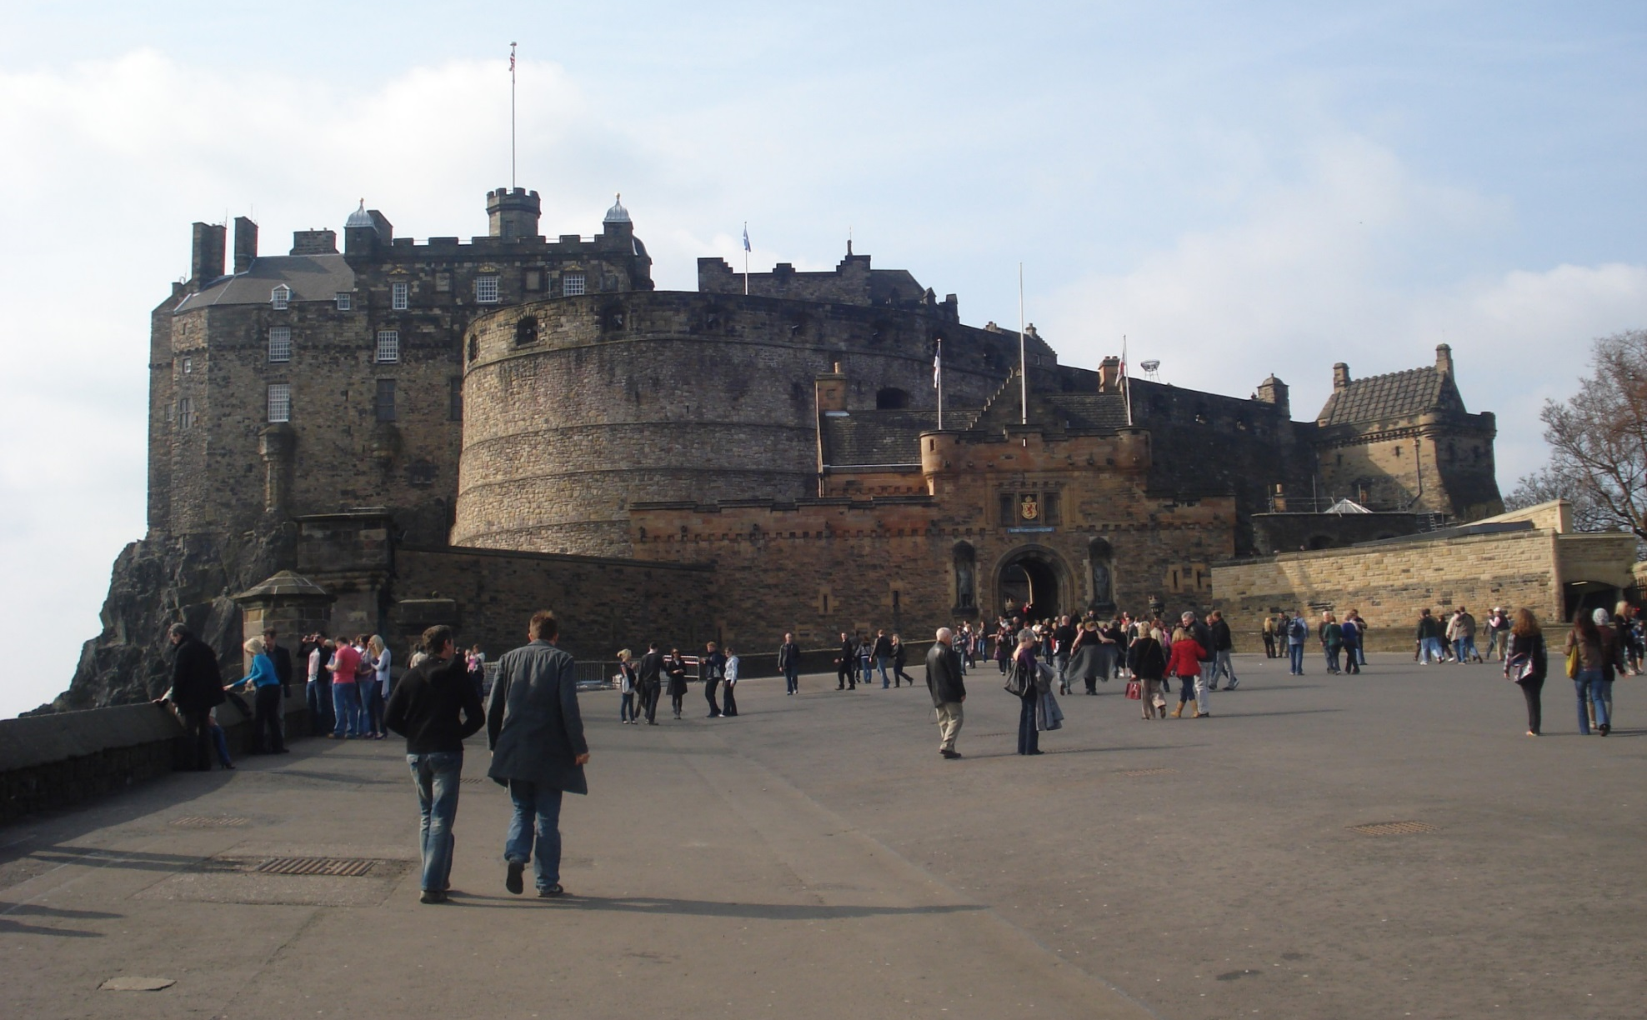
Edinburgh has a castle
Edinburgh Castle
Edinburgh Castle is a historic fortress, situated on Castle Rock. Castle Rock is a volcanic plug, which is thought to have risen approximately 350 million years ago.
Photo courtesy of kevgibbo (@flickr.com) - granted under creative commons licence - attribution

Slide 11
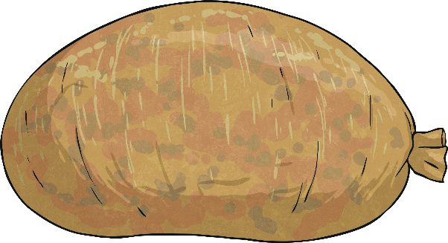
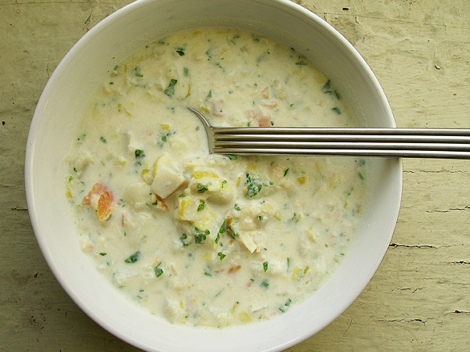
Scottish Foods
Haggis
Savoury pudding with sheep’s heart, liver and lungs, minced with onion, oatmeal, suet, spices and salt, stuffed inside a sheep’s stomach - although today a lot of haggis is prepared in a sausage casing.
Cullen Skink
A thick Scottish soup made with smoked haddock, potatoes and onions.
Photos courtesy of Pseph (@flickr.com) - granted under creative commons licence - attribution

Slide 12
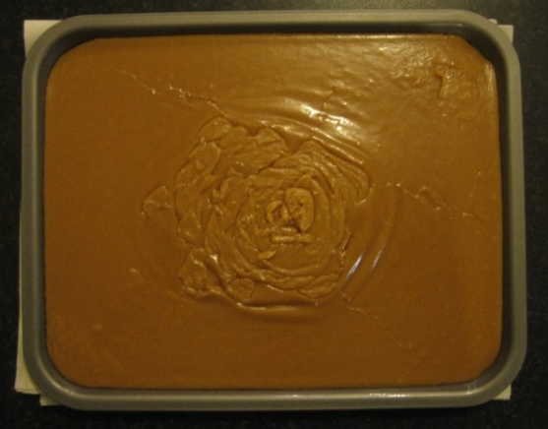
Scottish Foods
Tablet
A medium-hard sugary sweet made from sugar, condensed milk, butter and vanilla essence, boiled to a soft-ball stage and then allowed to crystallise.
Photo courtesy of Robert Scarth (@flickr.com) - granted under creative commons licence - attribution

Slide 13
St. Andrew’s Day
30th November
St. Andrew is the Patron Saint of Scotland. He was one of Jesus’ disciples. After Jesus had died, Andrew travelled and taught people about who Jesus was and about the amazing things he had done. However, the Romans were not happy about this and crucified Andrew on an x-shaped cross.
Many years later, some of Andrew’s bones were taken to Scotland and buried at the town of St. Andrews, where a church was built on top.
People remember and celebrate the life of St. Andrew on 30th November each year, both in Scotland and other parts of the world. In Scotland there are many festivities on this day including a ceilidh, where people take part in Scottish country dancing.
Image: Public domain

Slide 14
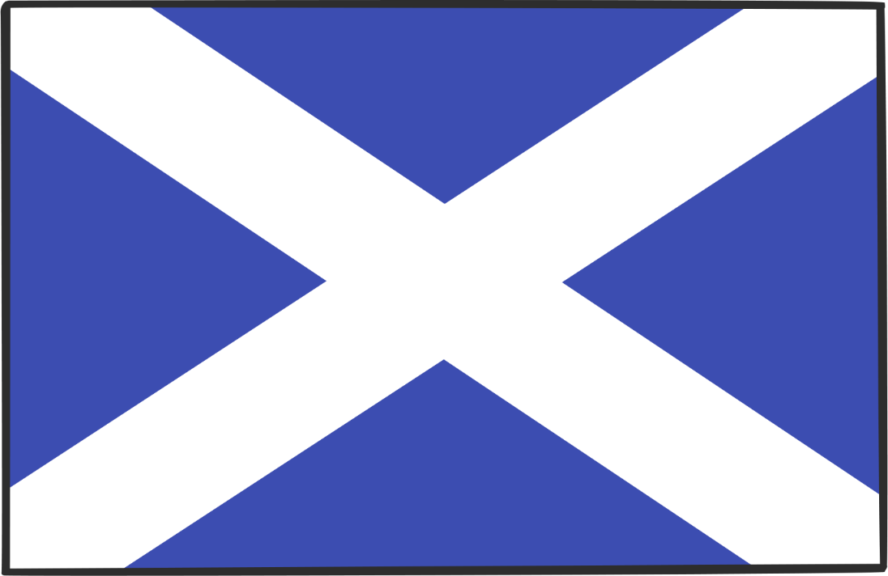
Scottish Flag
The Scottish people made Andrew their Patron Saint and chose a Saltire (Greek) Cross on a sea-blue background, as their flag. According to tradition it represents Saint Andrew who died on a cross of that shape.

Slide 15
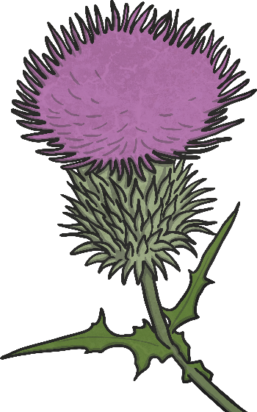
Scottish Symbols
Some legends of why the thistle is Scotland’s symbol, state that a group of Scots were sleeping in a field, when a group of Vikings crept up to attack them.
As they did so, one of the Vikings stood on a thistle and was pricked by its thorns. He cried out in pain, waking the sleeping Scots who were then able to fight off their attackers.

Slide 16
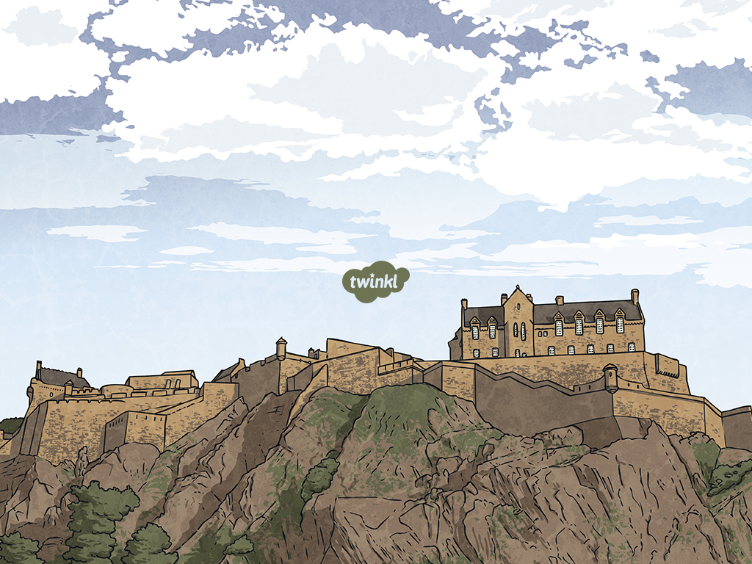
Bird found in Scotland?
Woodland animal found in Scotland?
What other interesting facts can you find out about Scotland?
Musical instrument played in Scotland
Traditional clothing in Scotland

