Slide 1
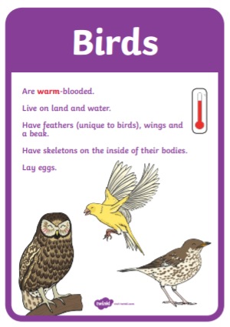
To classify an animal as a bird they need to have feathers, wings and a beak.

Slide 2
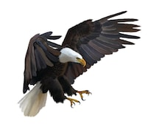
Can you label the bird?
talon
beak
wing
feather
head
body

Slide 3
Task:
All animals that fly, are they birds?
How many animals can you think of that fly?
You can draw them.

Slide 4
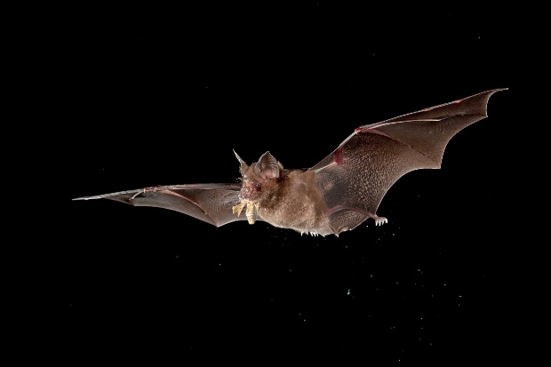
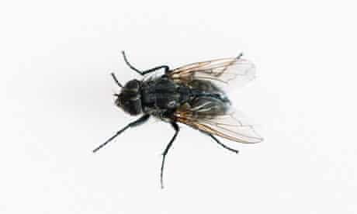
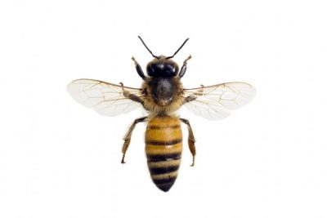
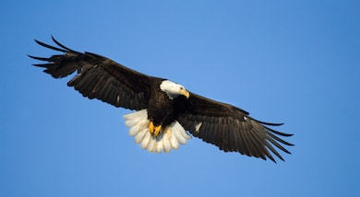
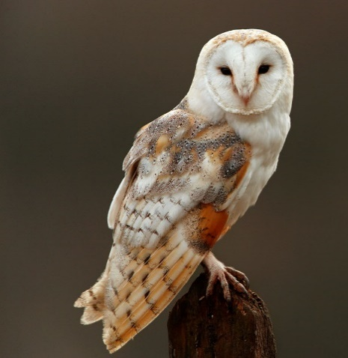
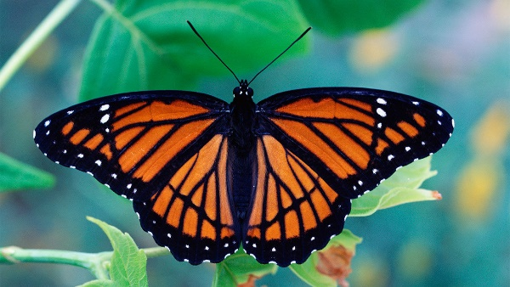
Which animals are not a bird?

Slide 5
Birds have wings but, do all birds fly?
Here are some clips to help answer your question
https://www.bbc.co.uk/bitesize/clips/z6ntsbk
https://www.bbc.co.uk/bitesize/topics/z6882hv/articles/zyd6hyc
Can you name the birds that cannot fly?

