Slide 2
What do you think needs to be included in a postcard?
Space in the top right corner for a stamp
Space for a picture (on the front).
Space to write about your holiday. This is where you write about what you have been doing on holiday.
Blank lines for an address for you to write the name and address of the person you are sending it to.

Slide 3
What might you write about in a postcard?
Maybe what you have done so far and what you are going to do?
Yesterday we went to the beach. Tomorrow we will go on a boat trip.

Slide 4
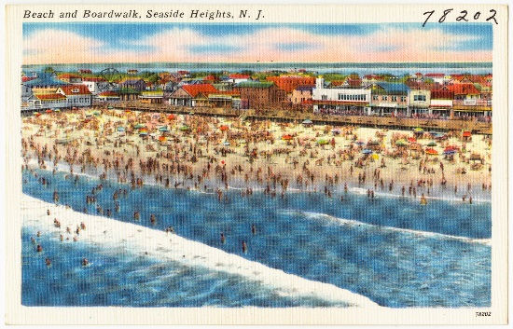
This is an example of what might be drawn on the front of a postcard. It could be drawn on or it could be a photograph.
Photo courtesy of Boston Public Library(@flickr.com) - granted under creative commons licence - attribution

Slide 5
Here is a blank postcard for you to copy.

